Slide 1
Syntax Directed Translation
Lecture 10
Section 5.1 - 5.3
Rokan Uddin Faruqui
Associate Professor
Dept of Computer Science and Engineering University of Chittaong, Bangladesh Email: rokan@cu.ac.bd

Slide 2
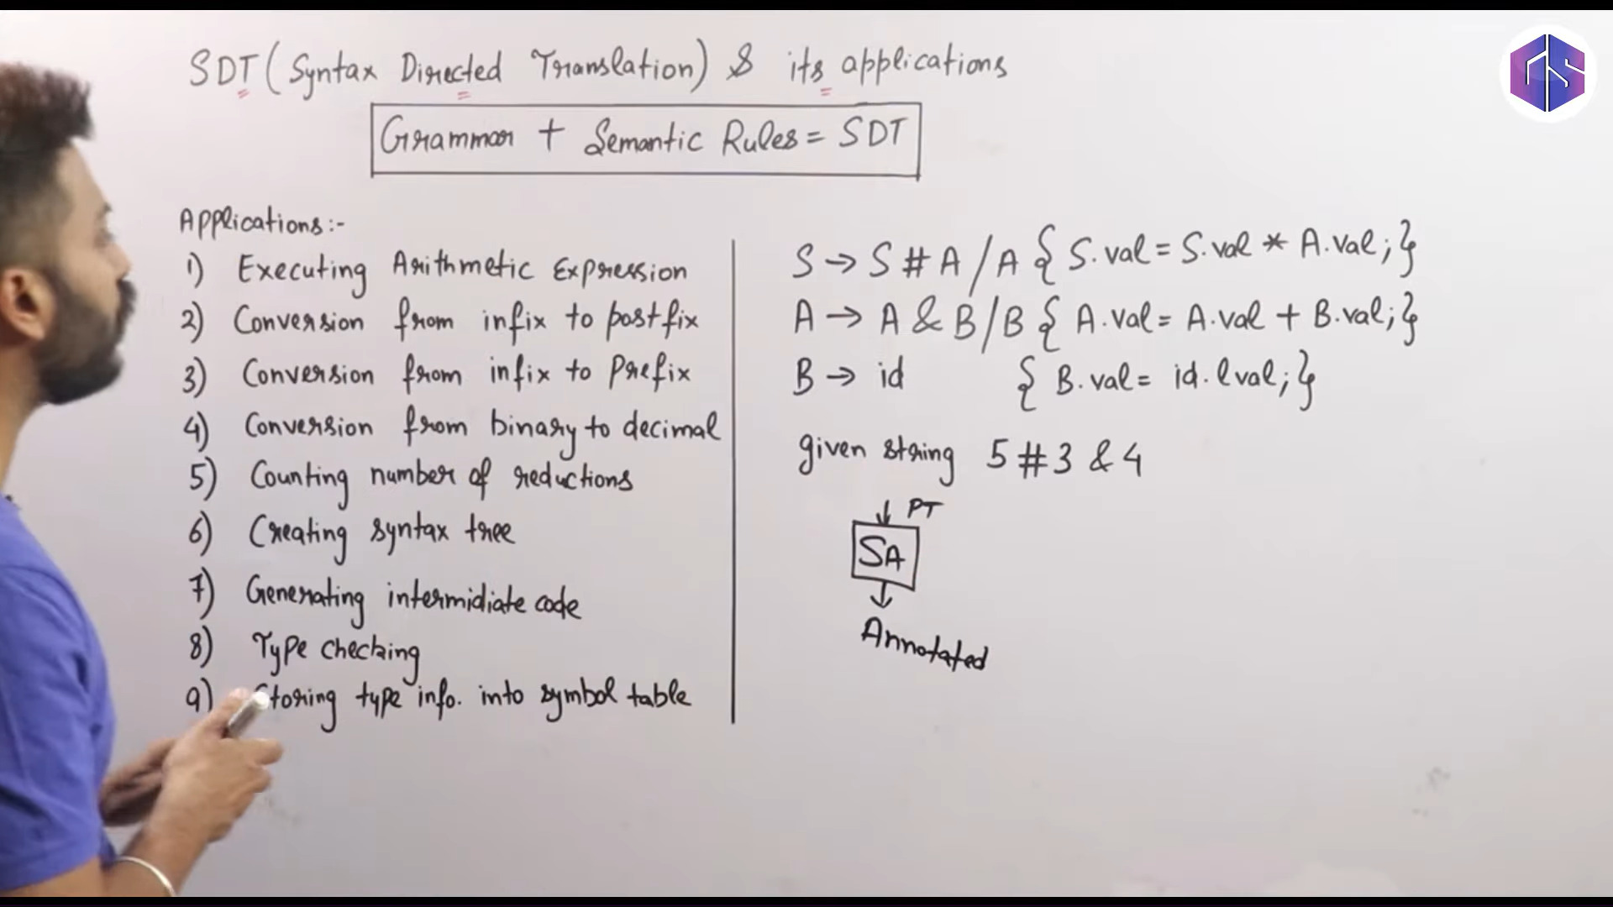

Slide 3
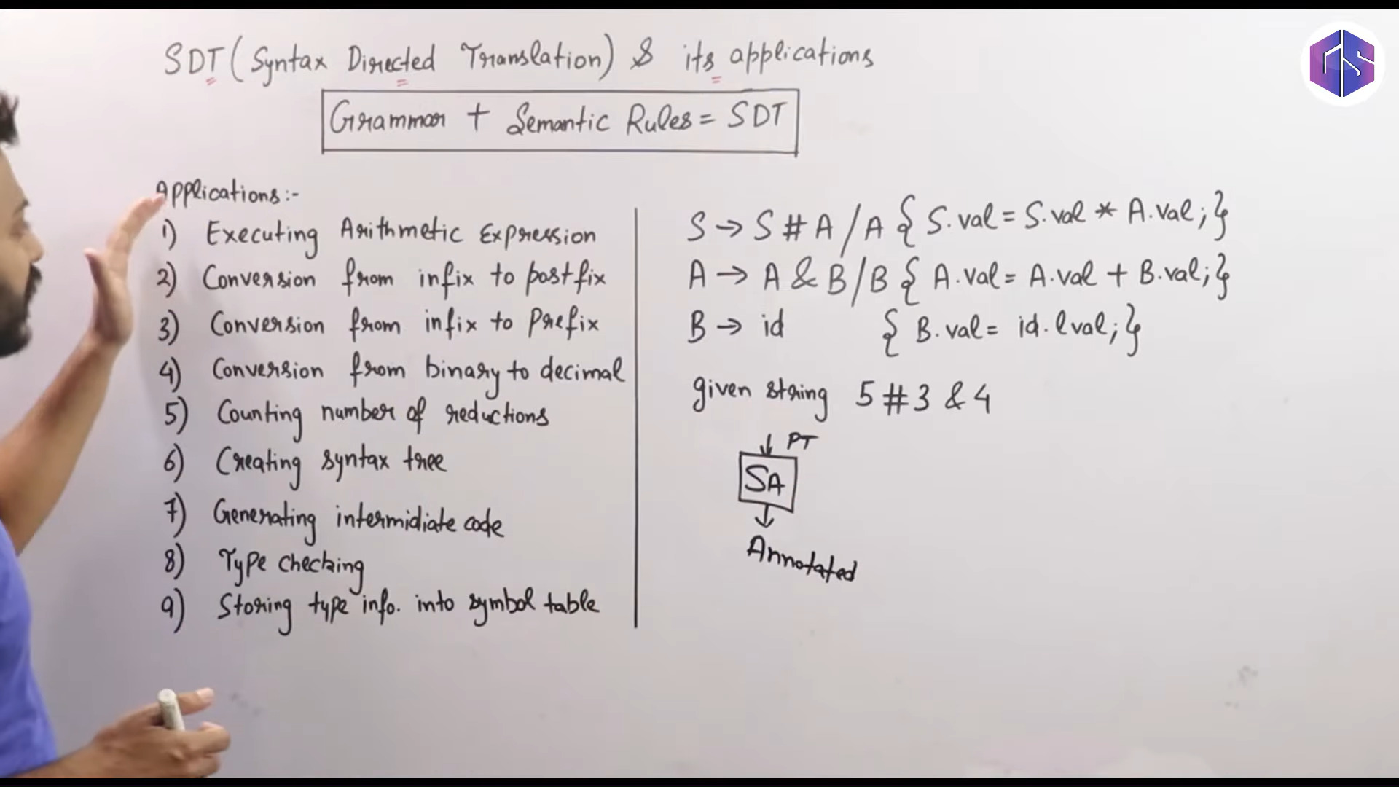

Slide 4
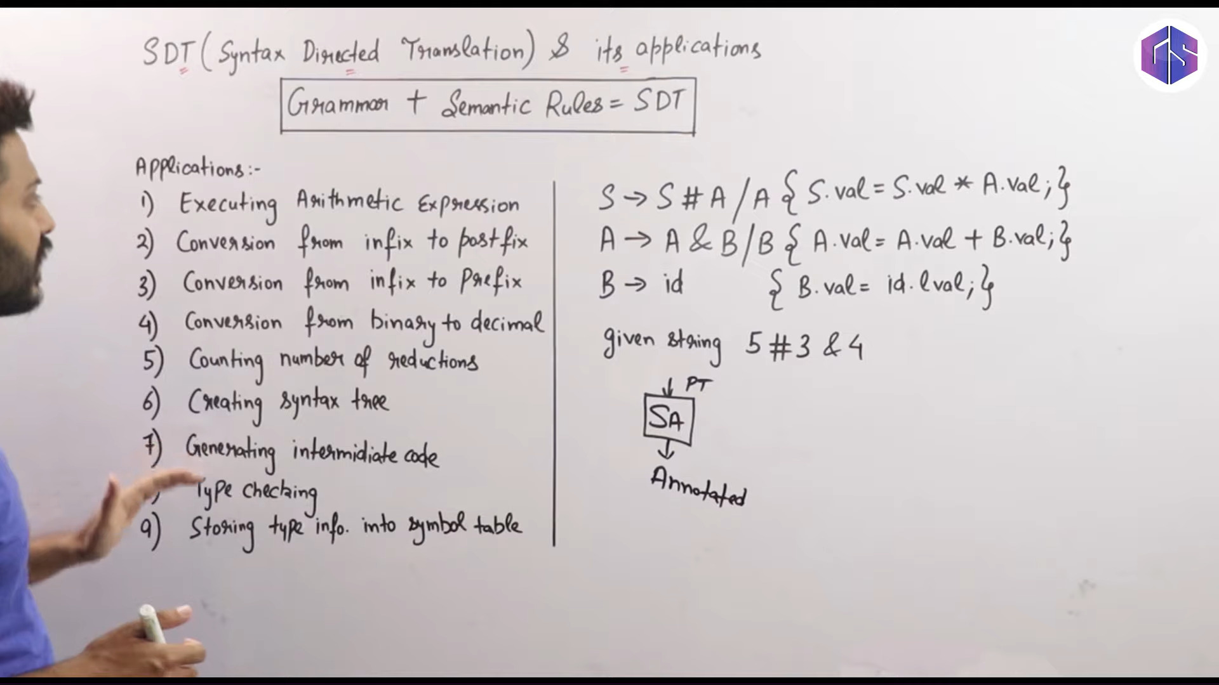

Slide 5
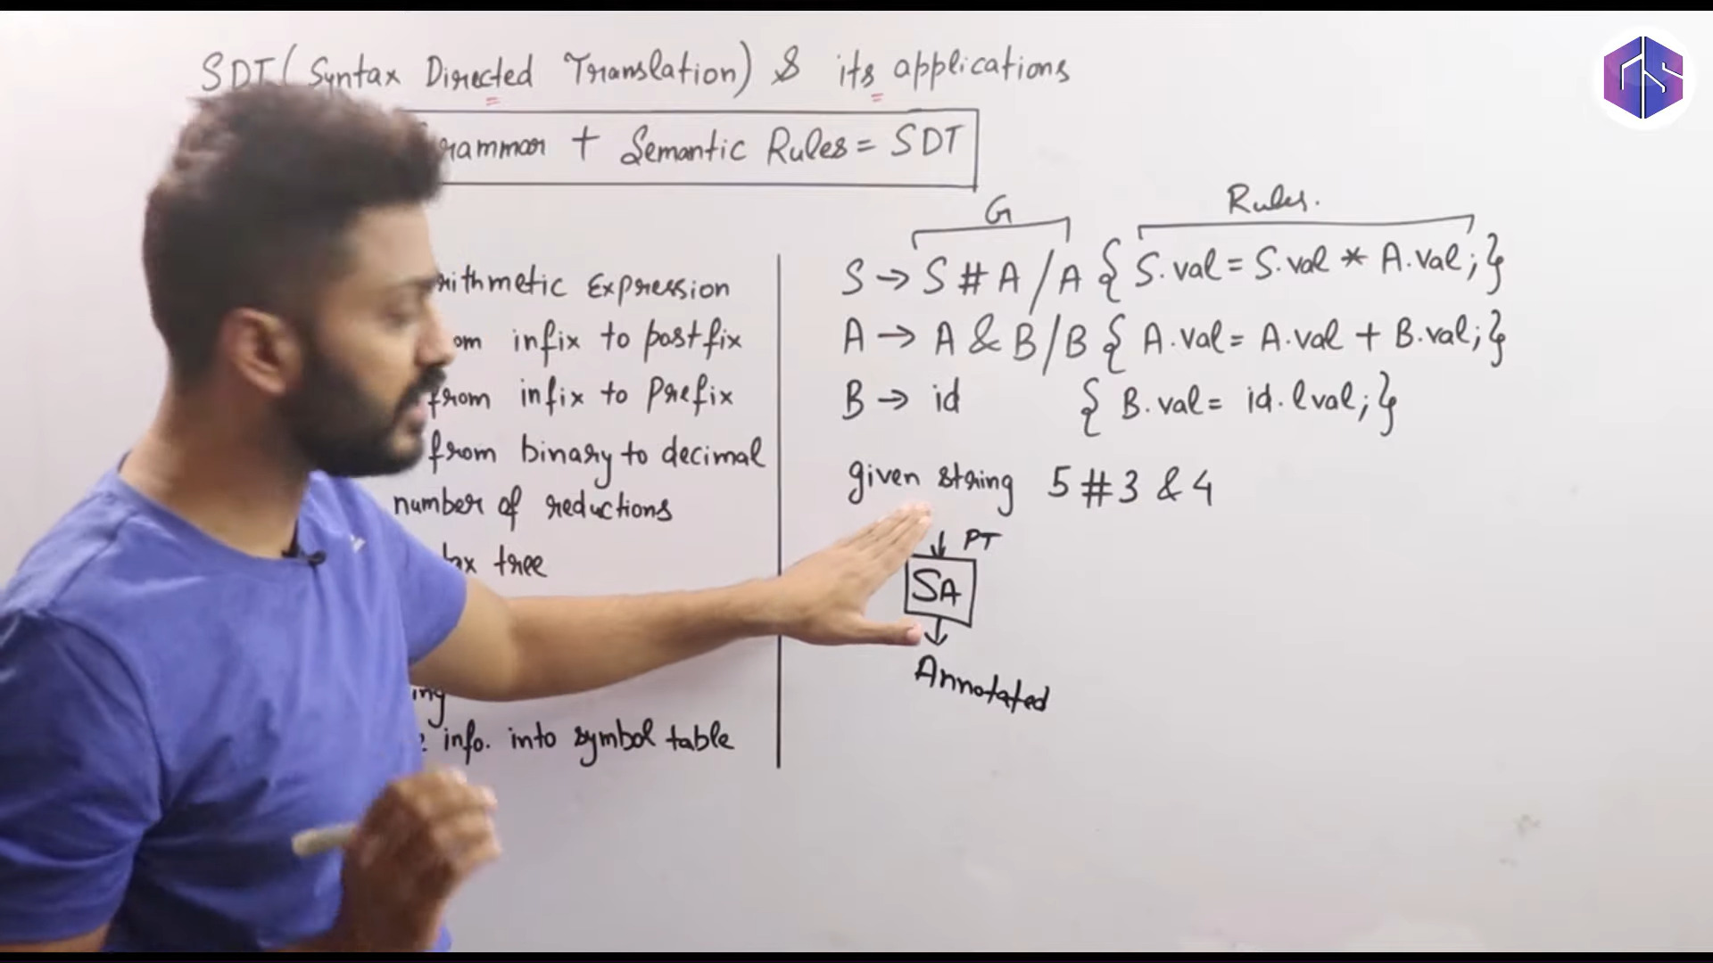

Slide 6
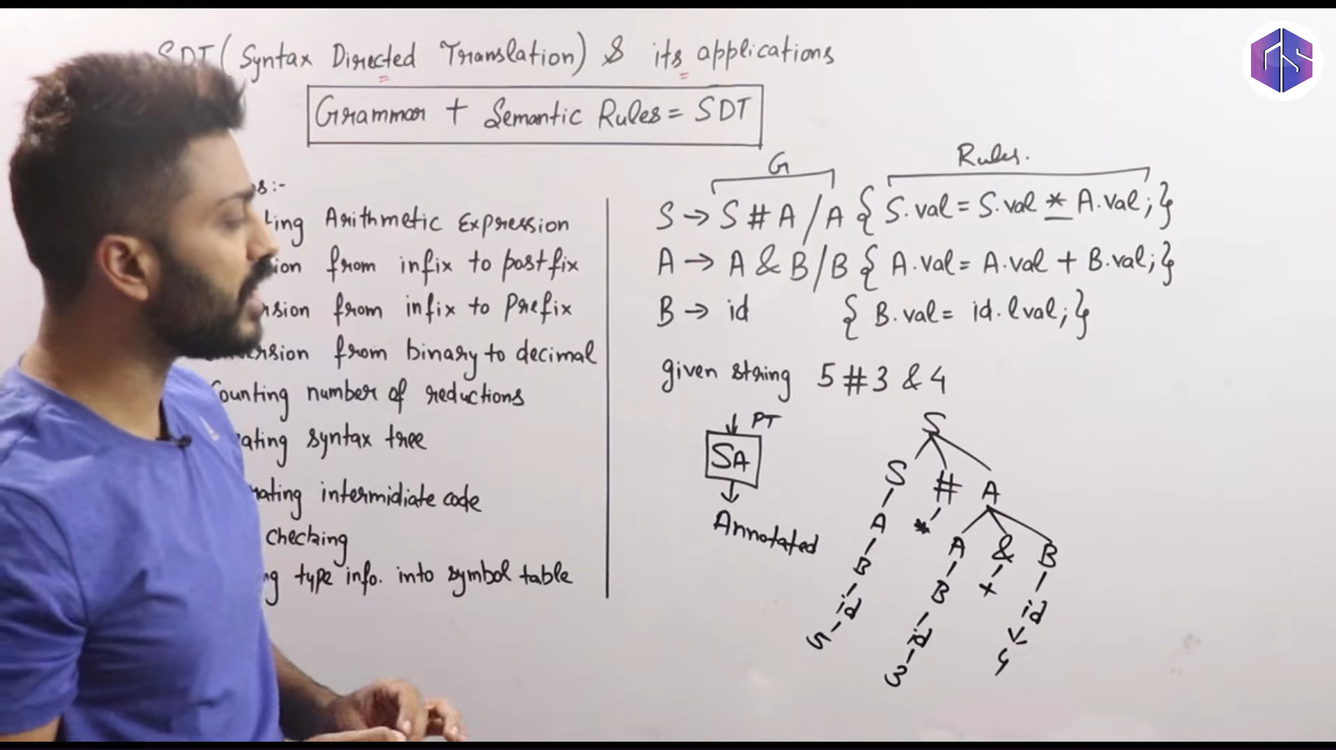

Slide 7
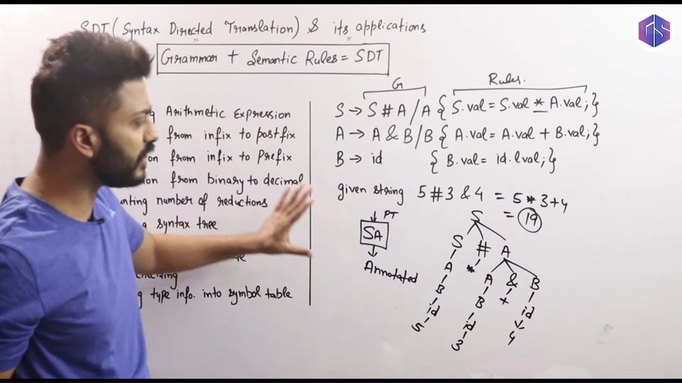

Slide 8
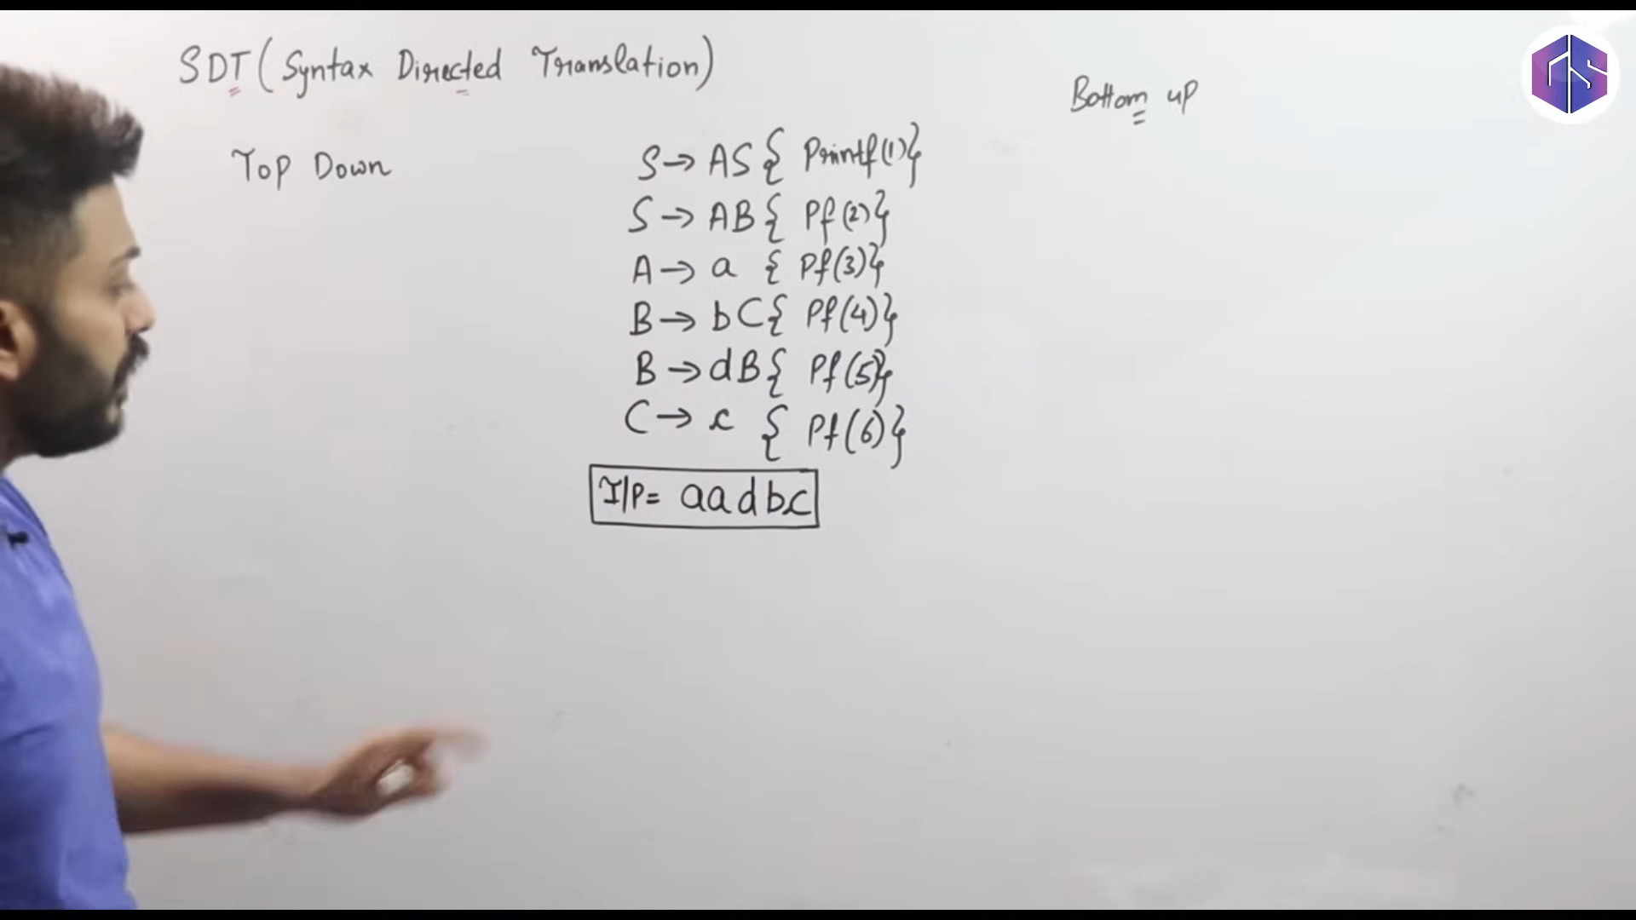

Slide 9
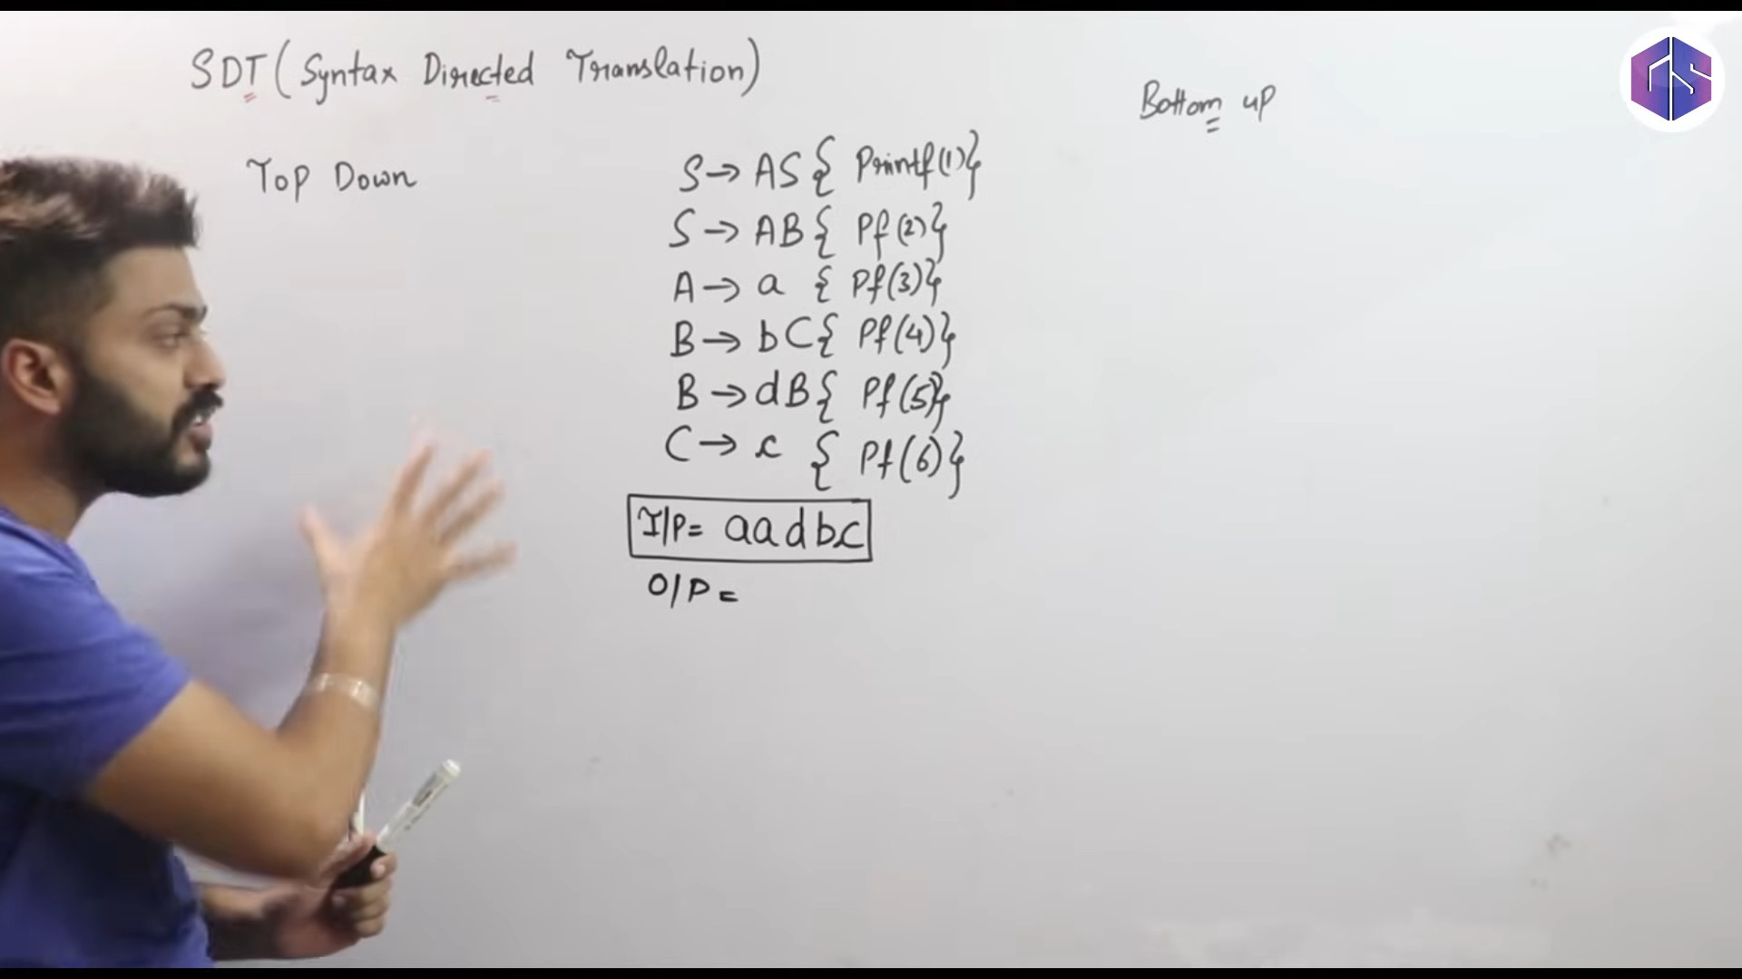

Slide 10
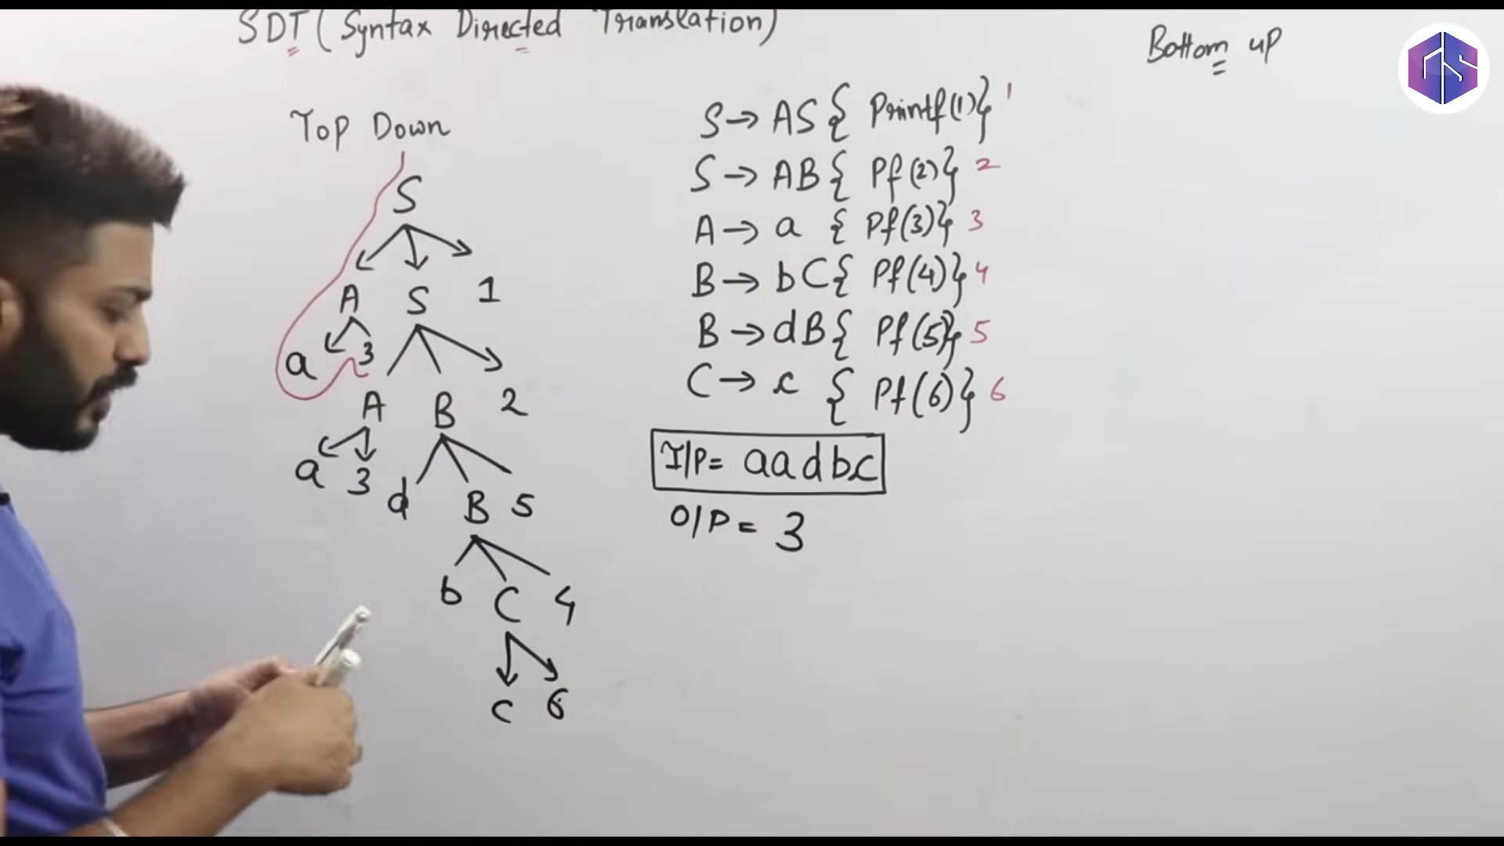

Slide 11
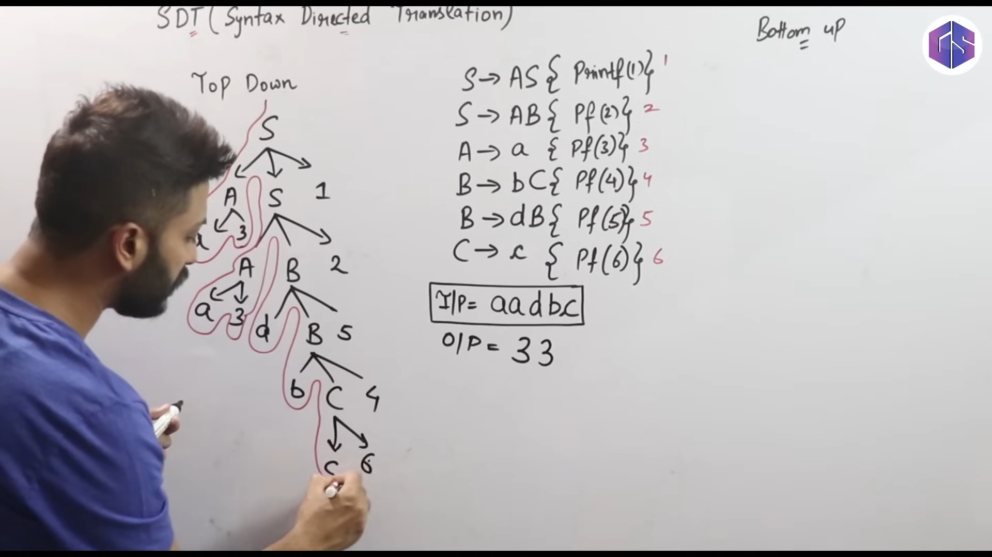

Slide 12
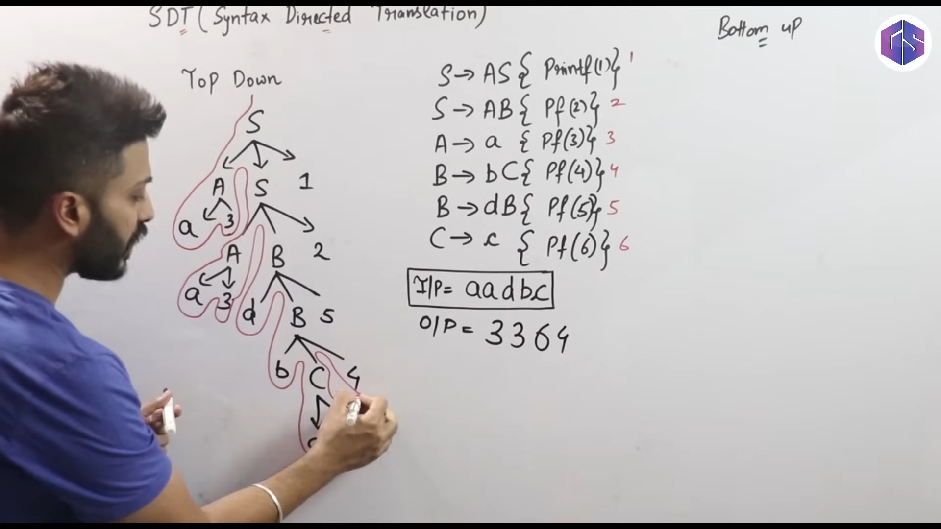

Slide 13
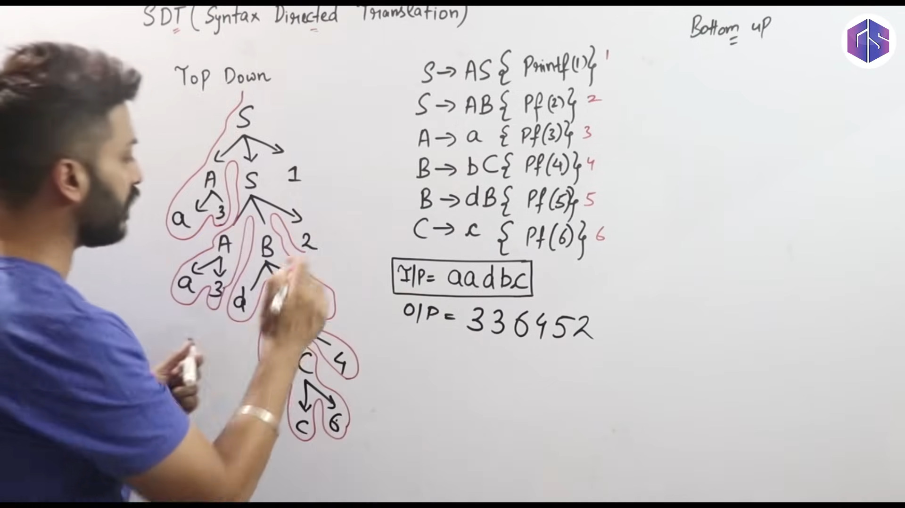

Slide 14
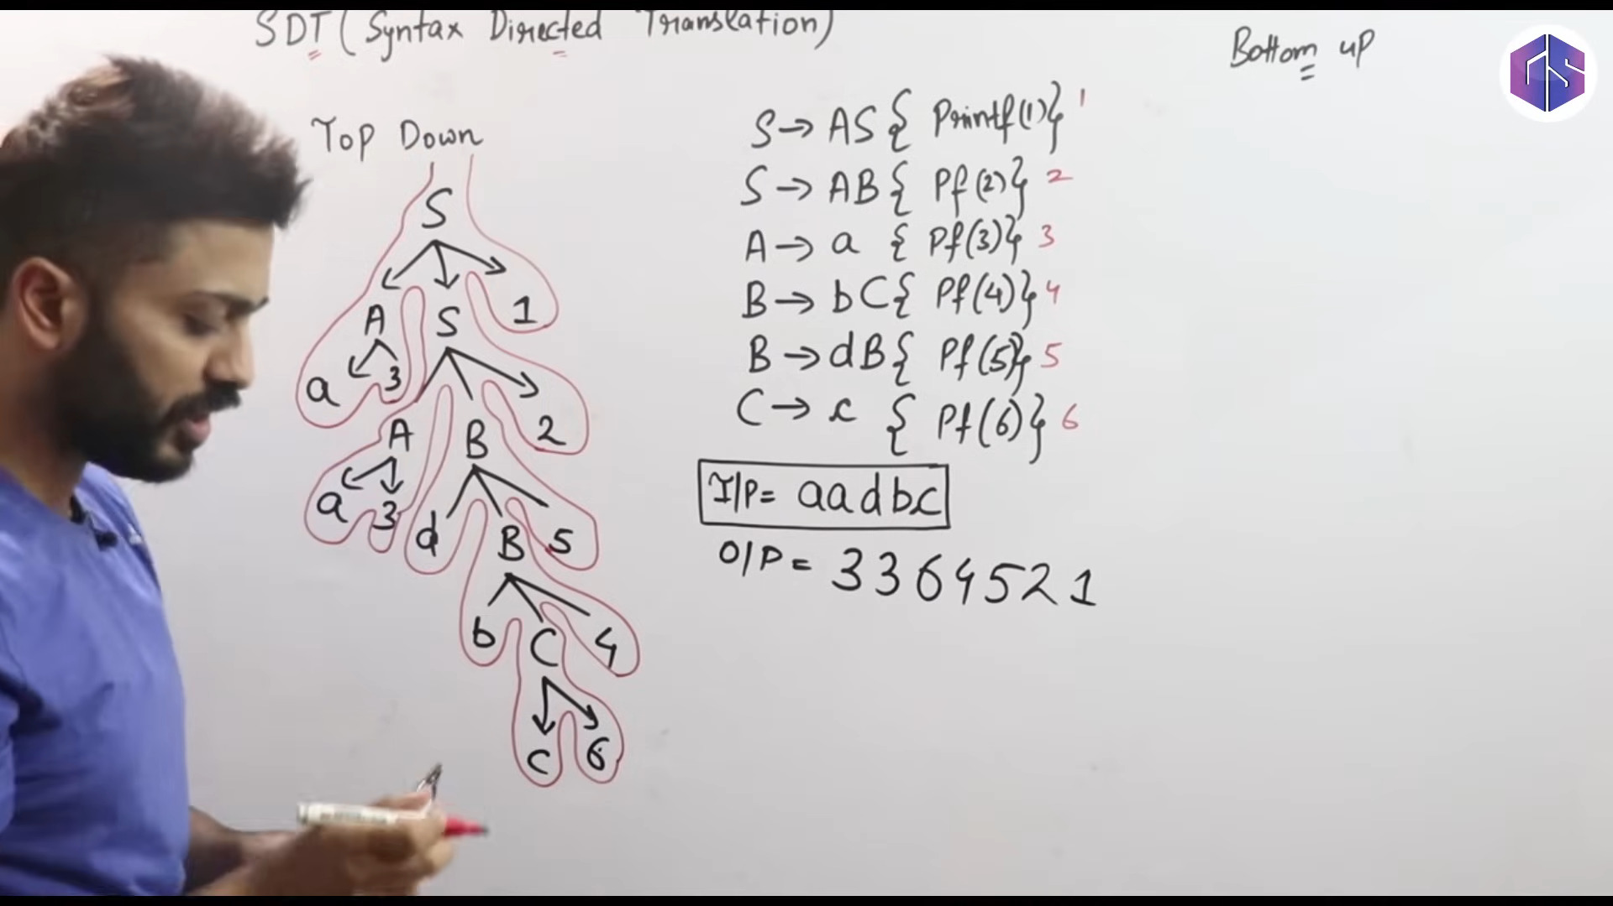

Slide 15
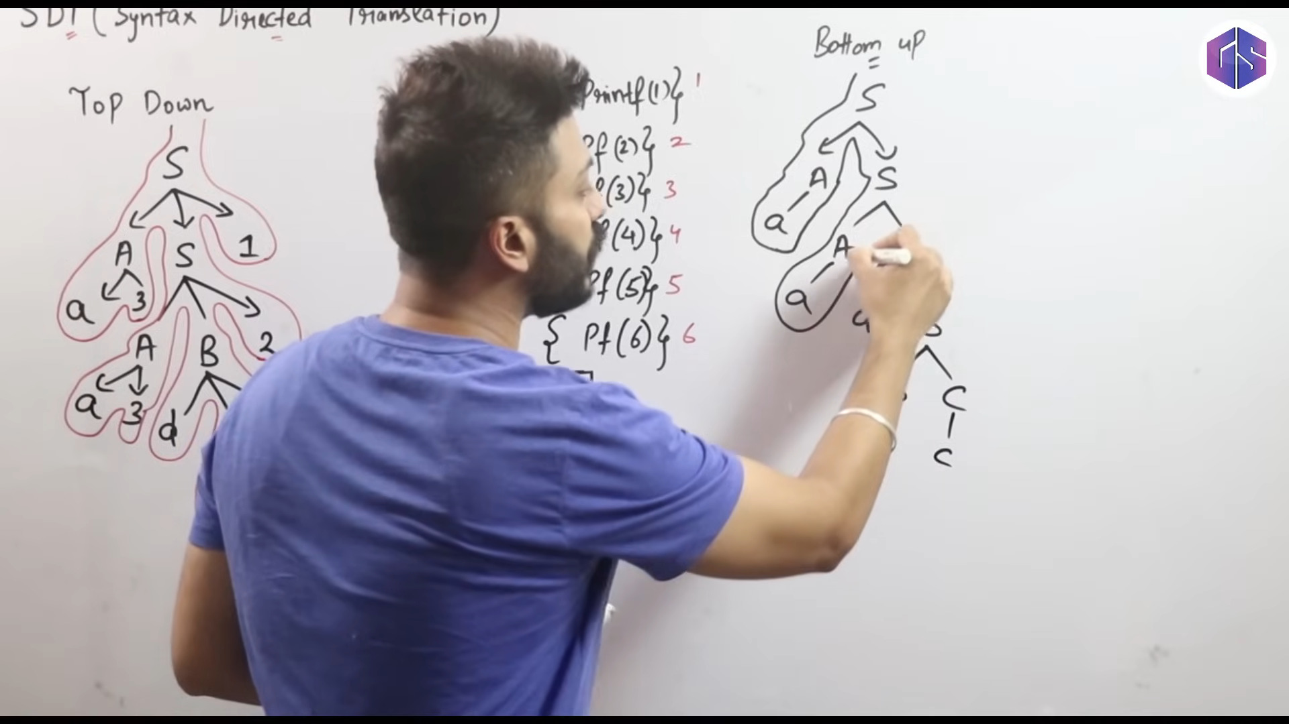

Slide 16
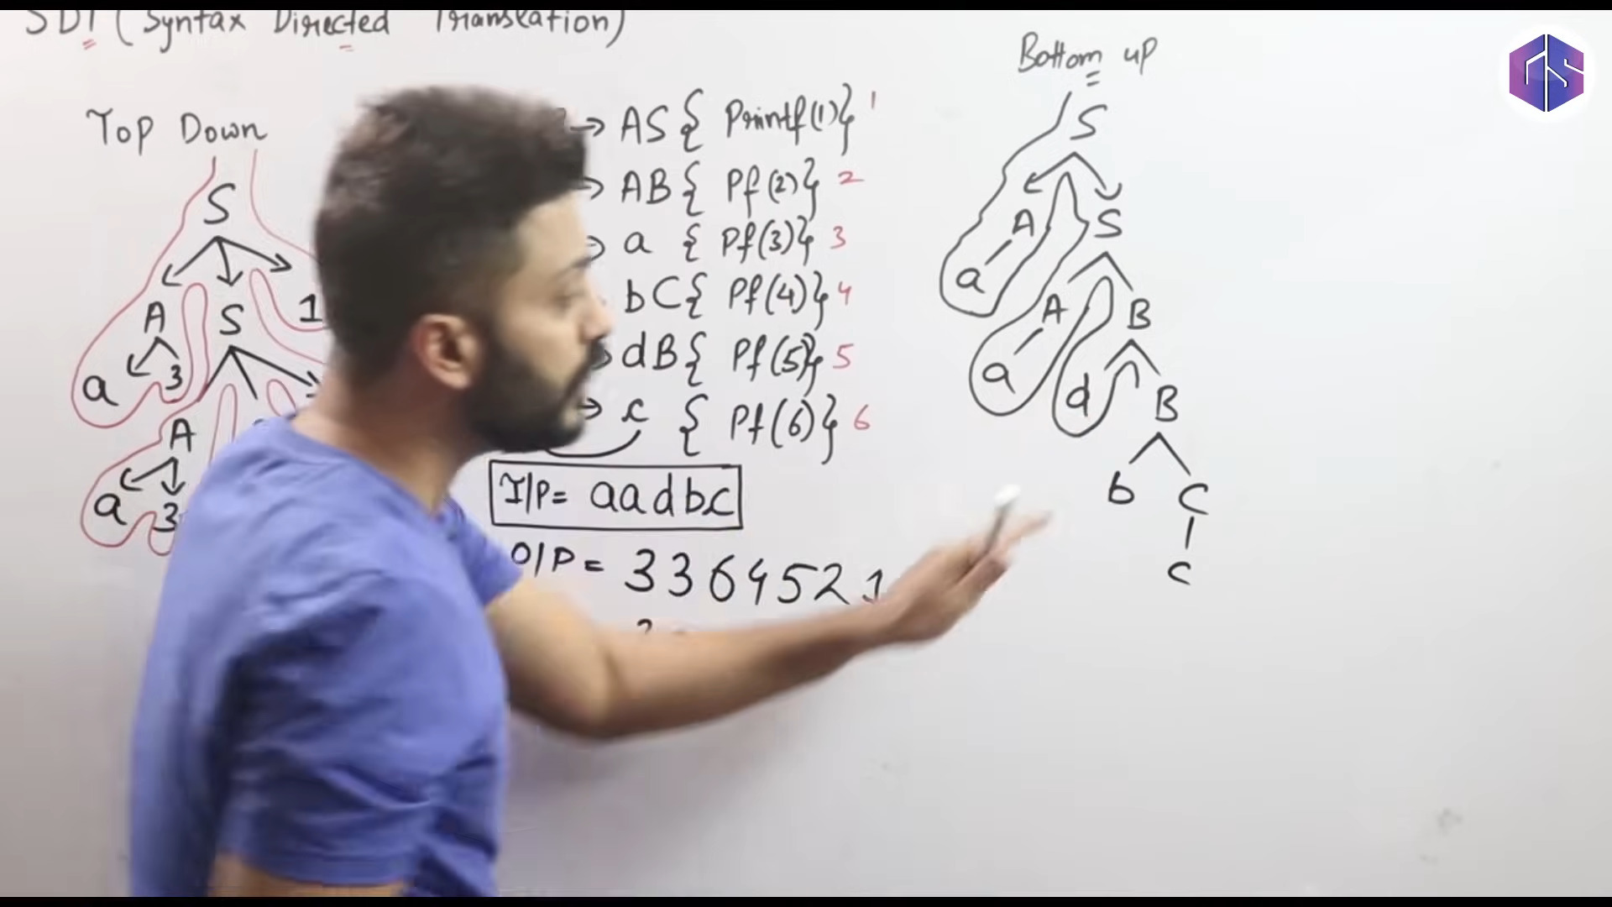

Slide 17
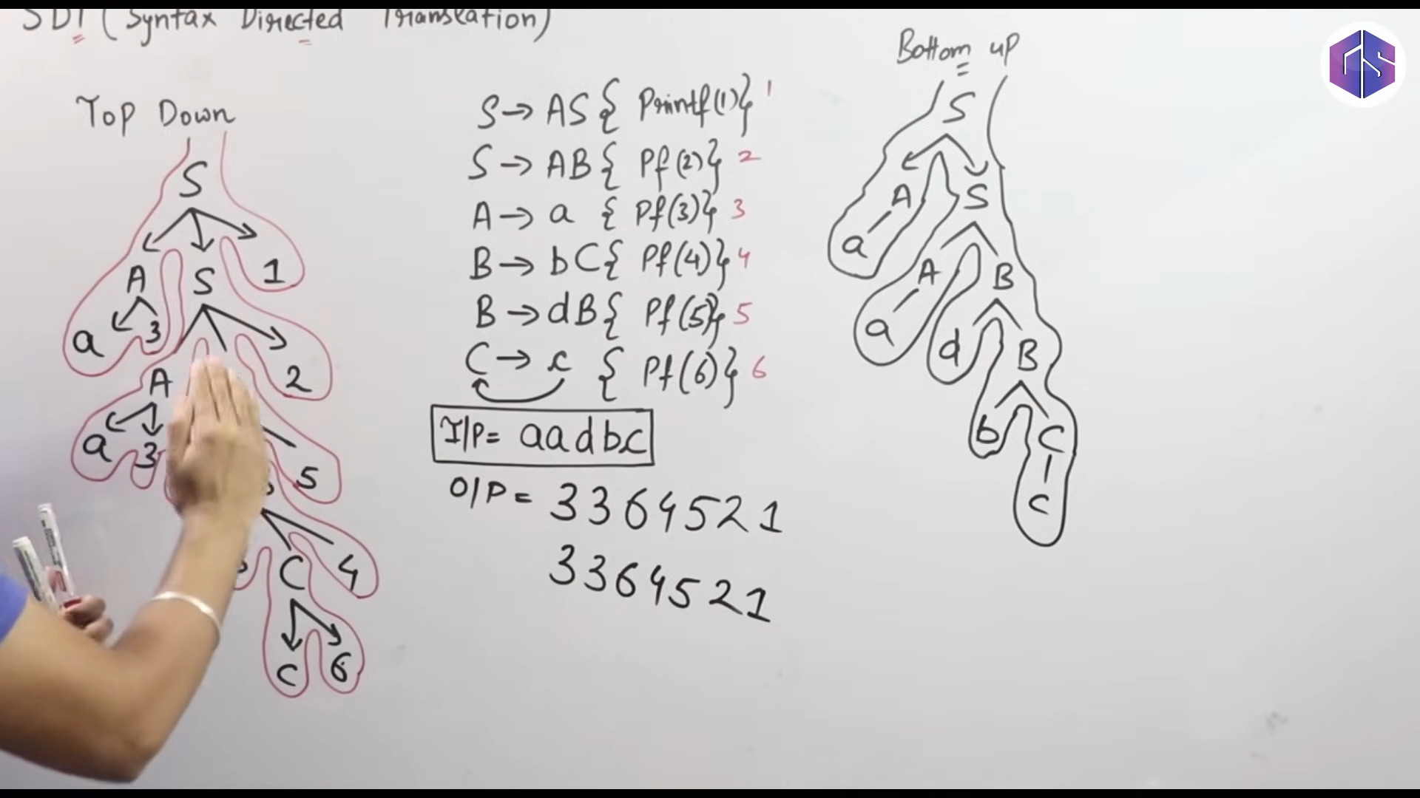

Slide 18
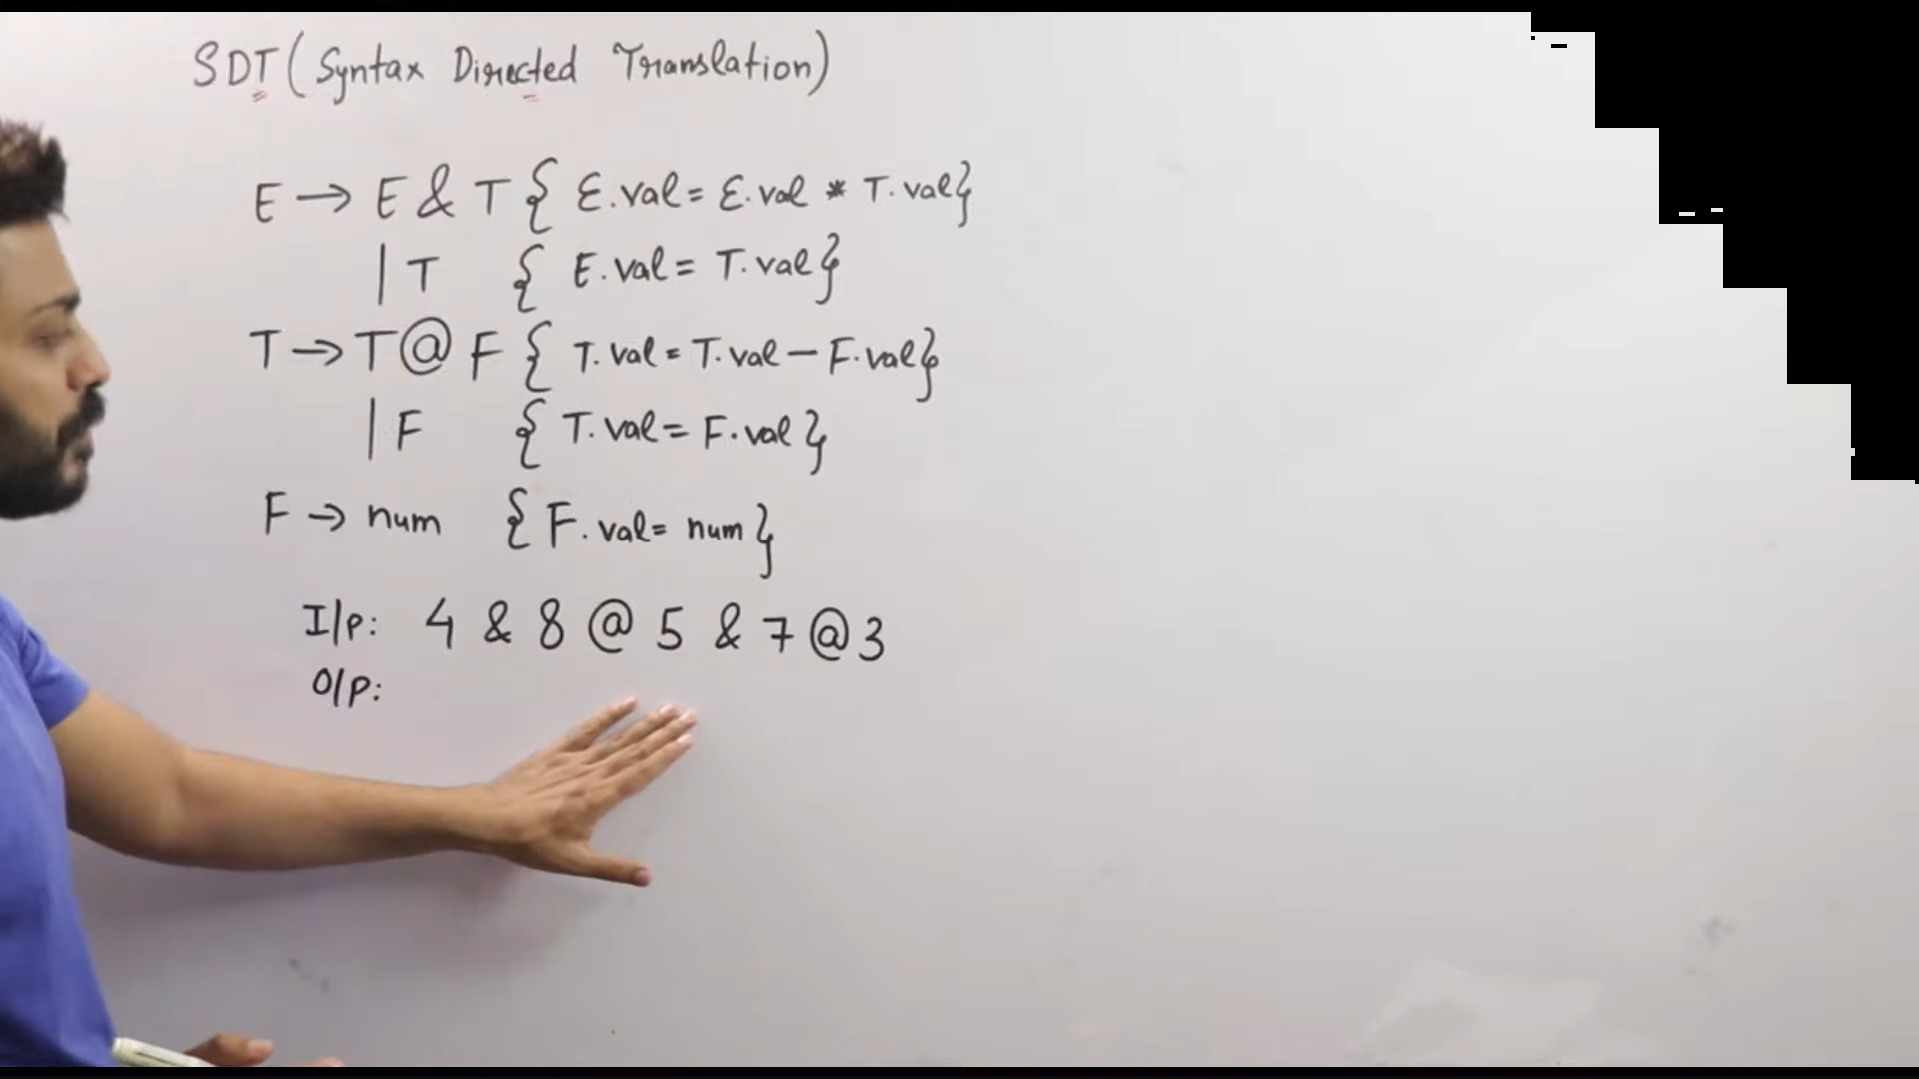

Slide 19
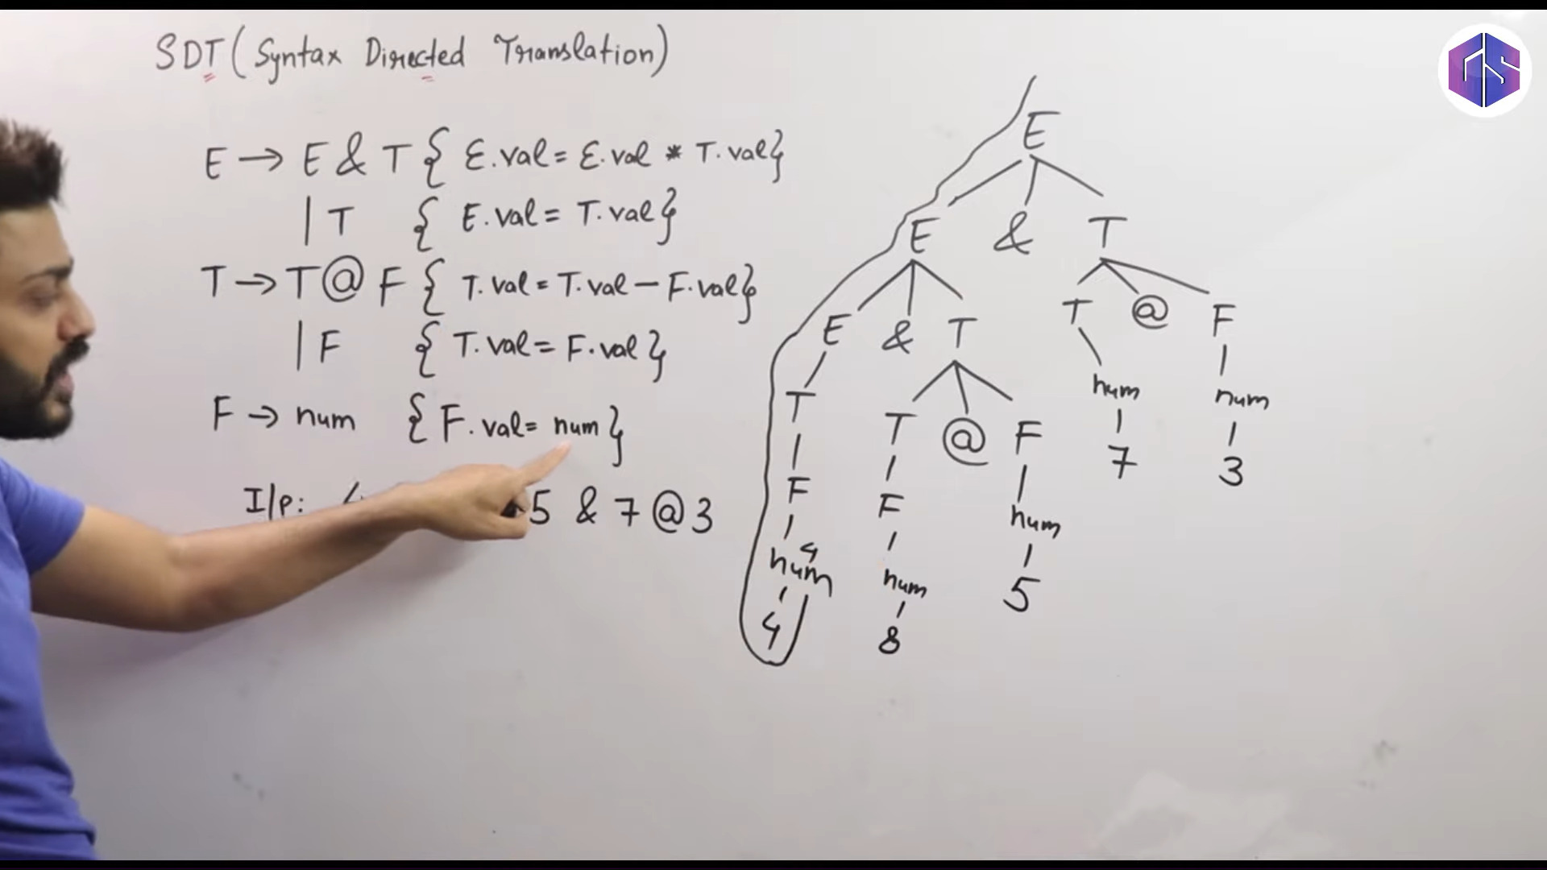

Slide 20
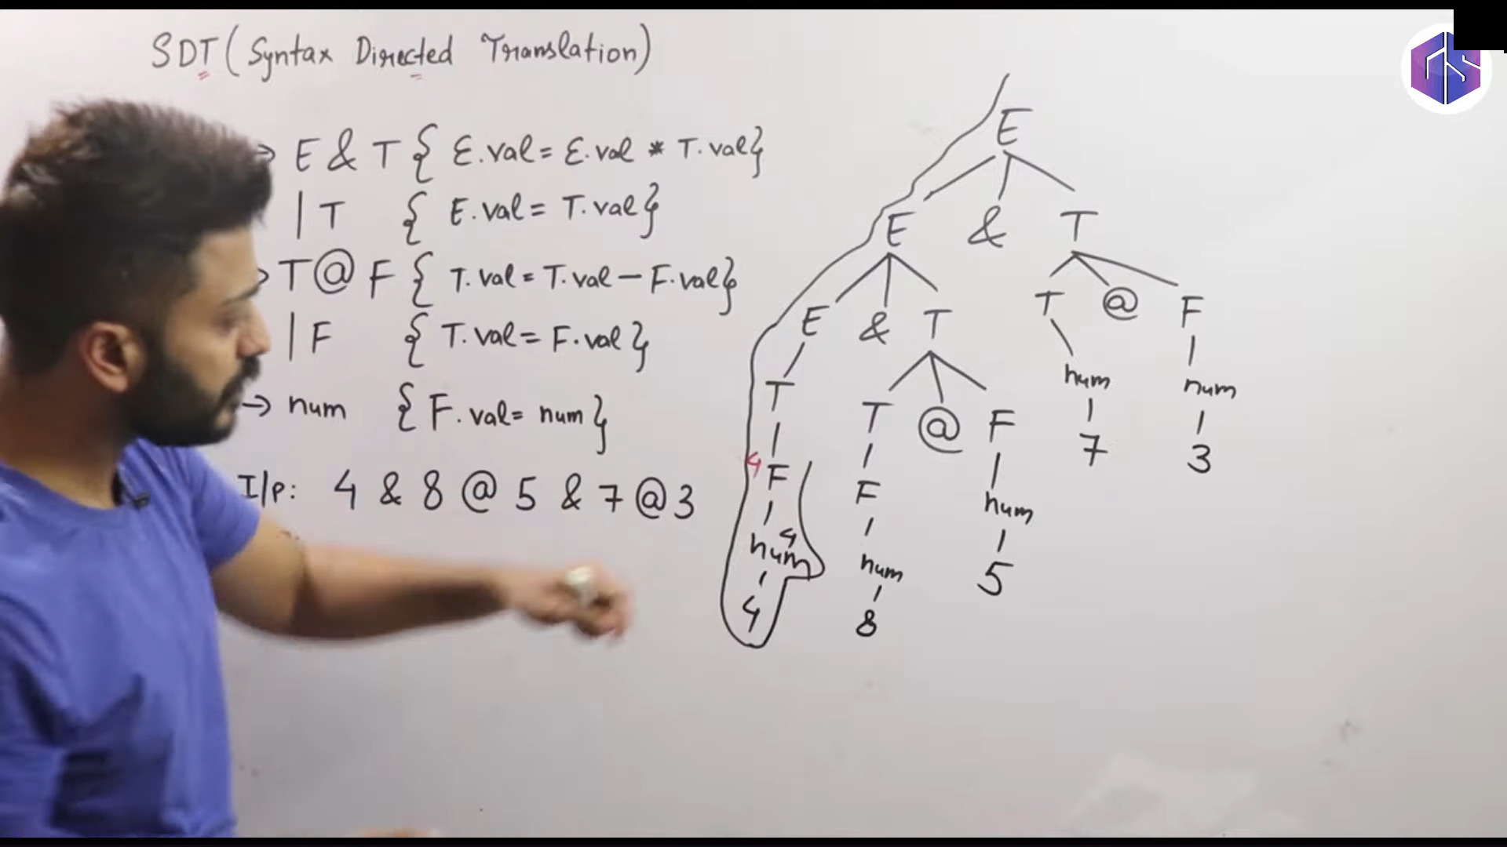

Slide 21
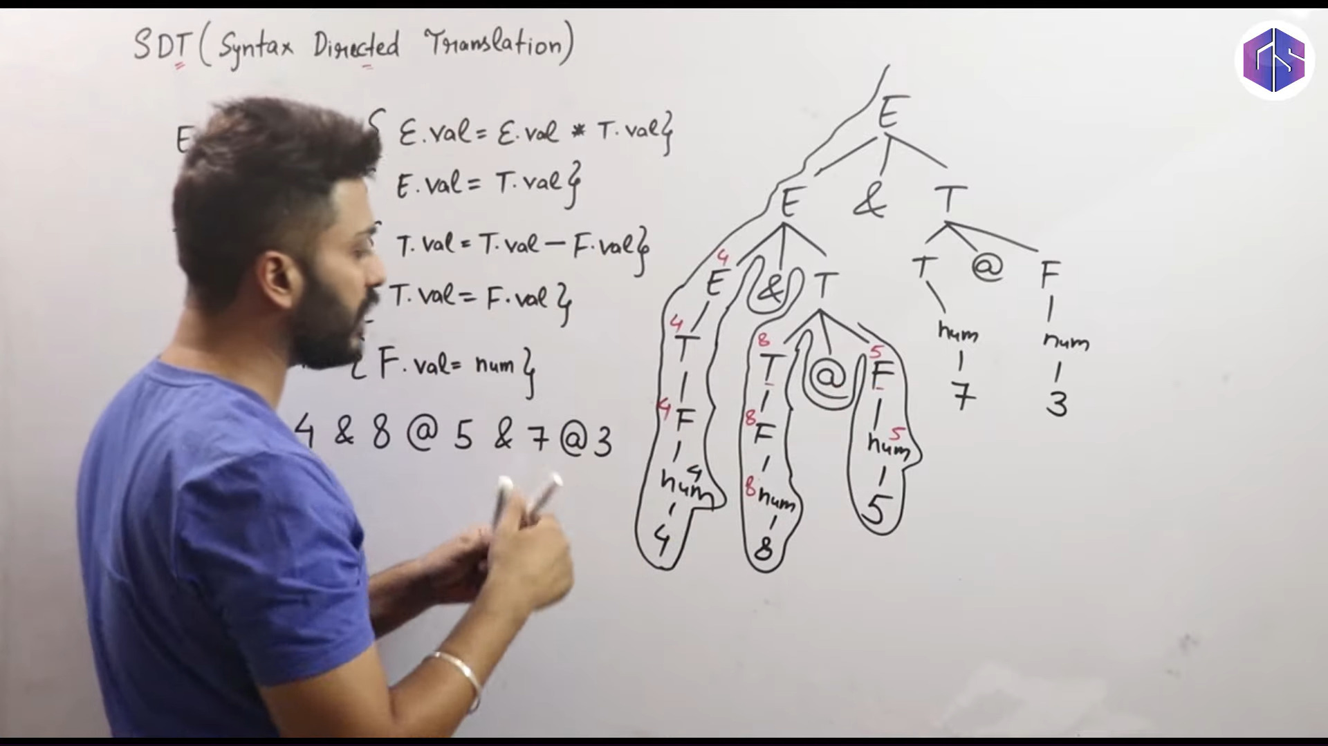

Slide 22
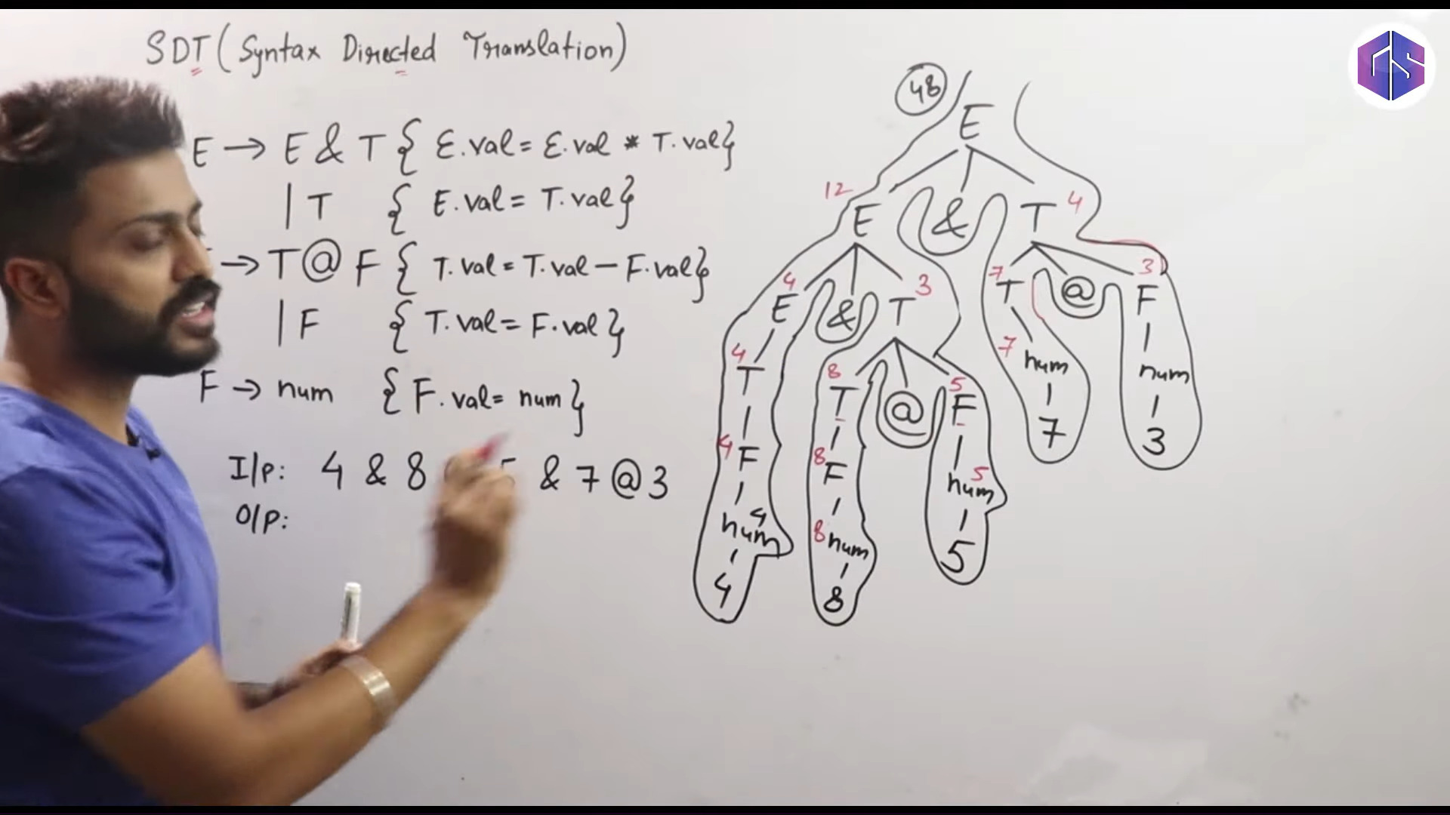

Slide 23







1
Abstract Syntax Trees
2
Syntax-Directed Definitions
3
Synthesized Attributes
4
Inherited Attributes
5
Examples
6
Assignment
Rokan Uddin Faruqui CSE, CU
Syntax Directed Translation
2

Slide 24






Outline
Abstract Syntax Trees
1 Abstract Syntax Trees
2 Syntax-Directed Definitions
Synthesized Attributes
3
4 Inherited Attributes
5 Examples
Assignment
6
Syntax Directed Translation

Slide 25
The Phases of Compilation
Abstract Syntax Trees
Source Program
Scanner (Lexical analysis)
Token Parser (Syntax analysis)
Symbol Table
Frontend
Tree Semantic analysis
Tree Intermediate code generation
IR
Machine-independent code optimization
IR
Target code generation
Backend
Target Code
Machine-specific code improvement (optional)
Target Code
Syntax Directed Translation

Slide 26
From Parse Tree/ Abstract Syntax Tree (AST)
Abstract Syntax Trees
position = initial + rate * 60
=
(id, 1)
+
id | lexeme
1 | position
2 | initial
3 | rate
(id, 2)
*
(id, 3)
(num, 60)
Syntax Directed Translation

Slide 27
static type checking
Abstract Syntax Trees
Type Checking, semantic analysis that resulta
annotated tree
t = float
=
t = float
id | lexeme | t
1 | position | float
2 | initial | float
3 | rate | float
hid, 1i
+
t = float
t = float
hid, 2i
*
t = float
hid, 3i
hnum, 60i
t = float
t = int
Syntax Directed Translation

Slide 28
Parse Trees
Abstract Syntax Trees
E => E + T
A parse tree shows the grammatical structure of a statement.
It includes all of the grammar symbols (terminals and nonterminals) that were encountered during parsing.
Syntax Directed Translation

Slide 29
Abstract Syntax Trees
Abstract Syntax Trees
An abstract syntax tree (AST) shows the logical structure of the statement.
Each node represents an action to be taken by the program or an object to be acted upon.
The syntax tree may introduce operations that were not in the source code or the grammar.
Dereferencing operations.
Type-casting operations. Jump statements.
Syntax Directed Translation

Slide 30
Syntax Trees vs. Parse Trees
Abstract Syntax Trees
Example (Syntax Trees and Parse Trees) Consider the statement a = 2*b + c;
stmt
=
lval
=
expr
;
a
+
id
expr
+
expr
id
*
DEREF
expr
*
expr
2
DEREF
c
num
id
b
Parse Tree
Syntax Tree
Syntax Directed Translation

Slide 31
Syntax Trees vs. Parse Trees
Abstract Syntax Trees
The parse tree never really exists, except insofar as the parser follows its logical order.
The AST builder builds the syntax tree from the information obtained by the parser.
Then the code generator writes the assembly code from the syntax tree.
Syntax Directed Translation

Slide 32
Abstract Syntax Trees
Abstract Syntax Trees
Recursive descent parsers generally create a single AST for the entire program.
They build the tree from root to leaf.
In bottom-up parsing, the AST will be built from the bottom up.
Syntax Directed Translation

Slide 33


Outline
Syntax-Directed Definitions
1 Abstract Syntax Trees
2 Syntax-Directed Definitions
Synthesized Attributes
3
4 Inherited Attributes
5 Examples
Assignment
6
Syntax Directed Translation

Slide 34
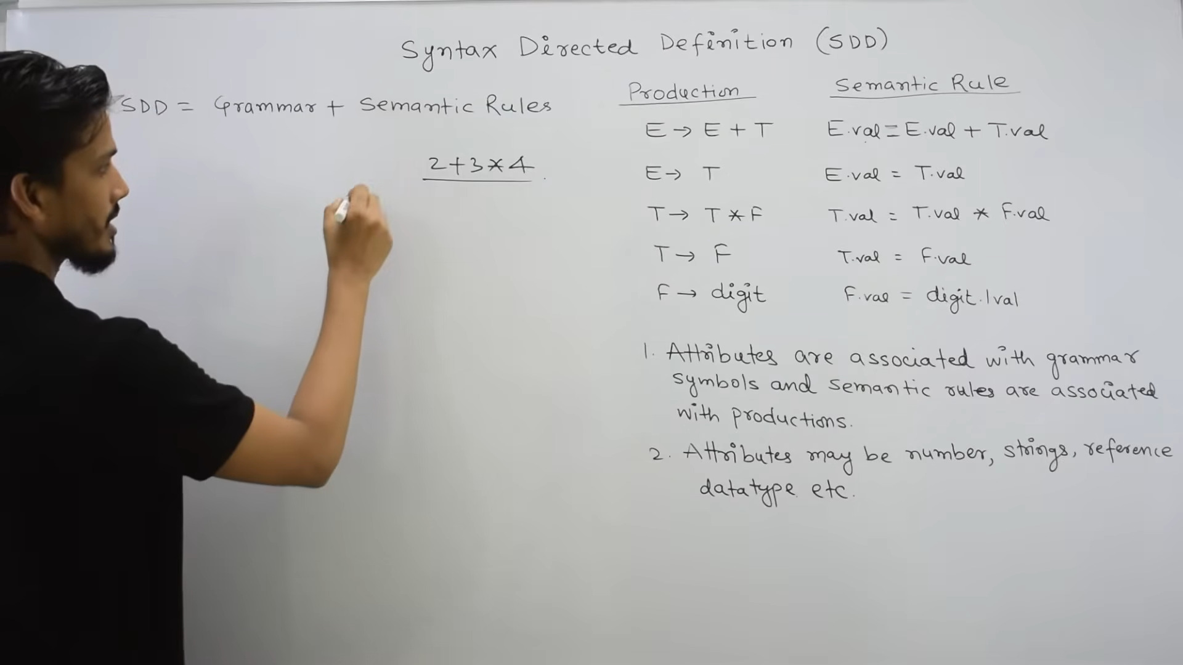

Slide 35
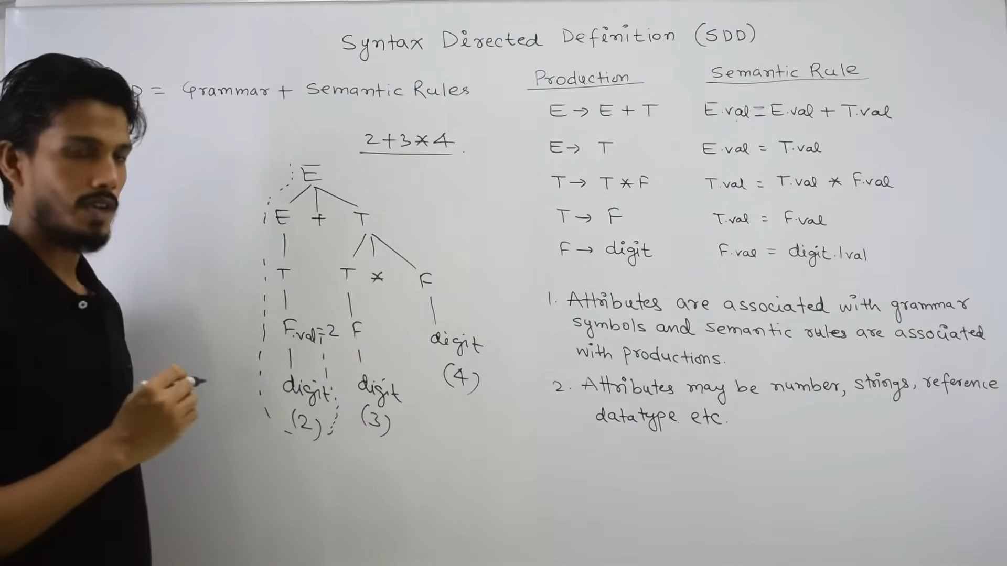

Slide 36
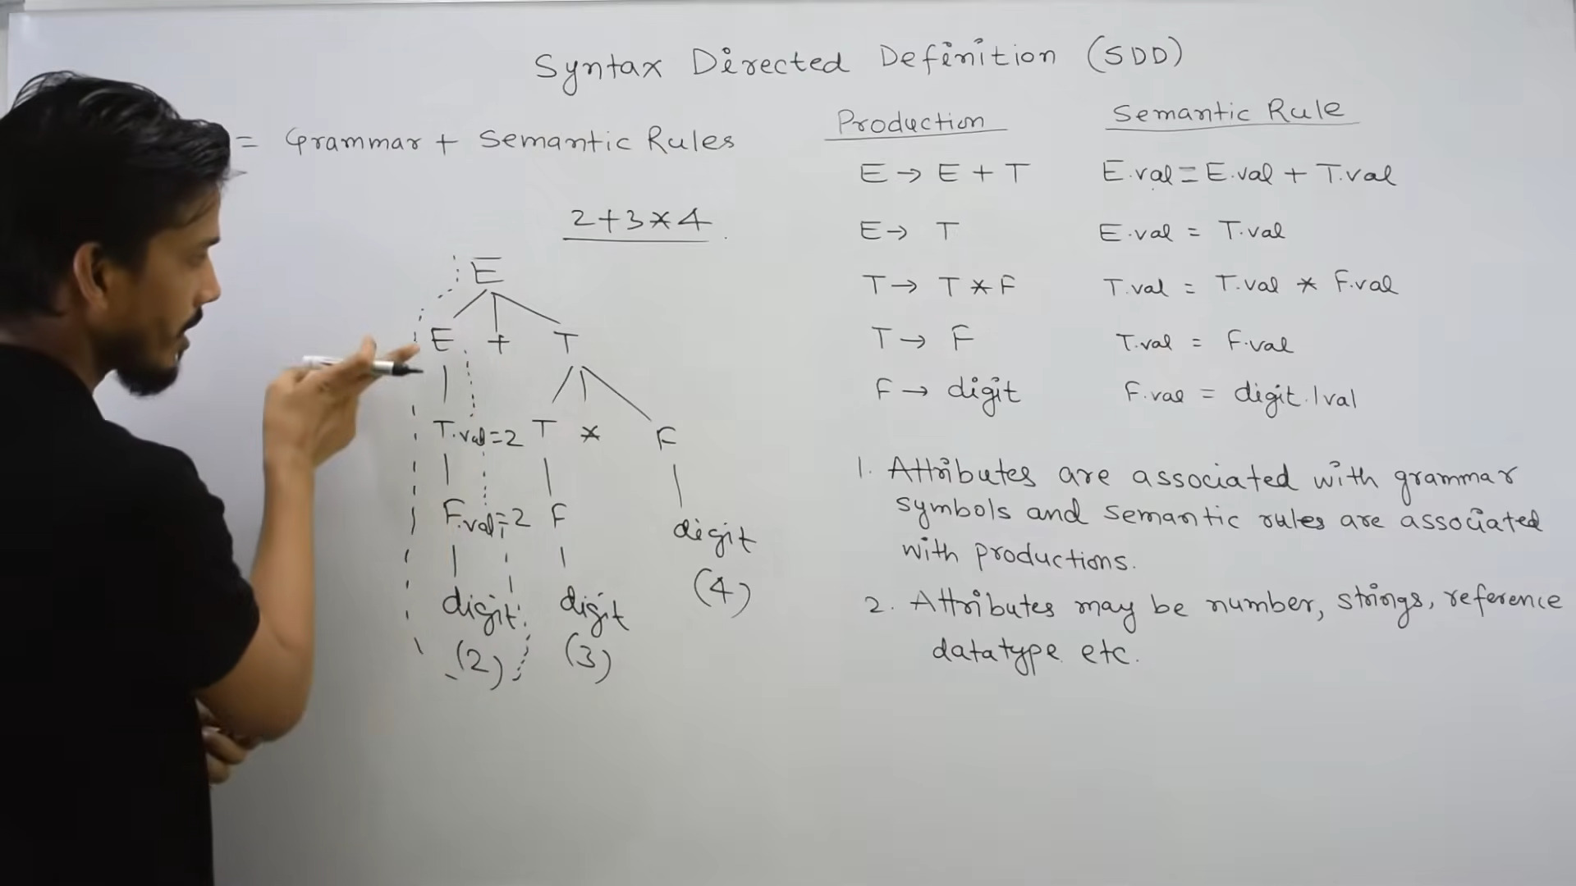

Slide 38
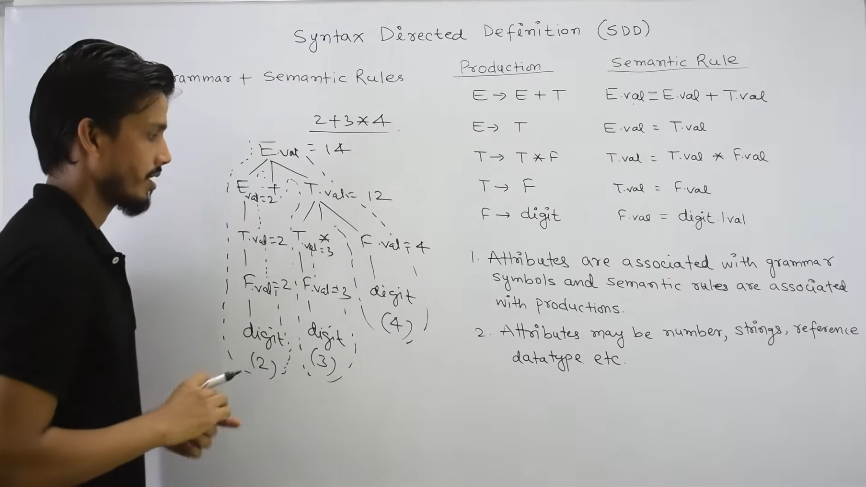

Slide 39
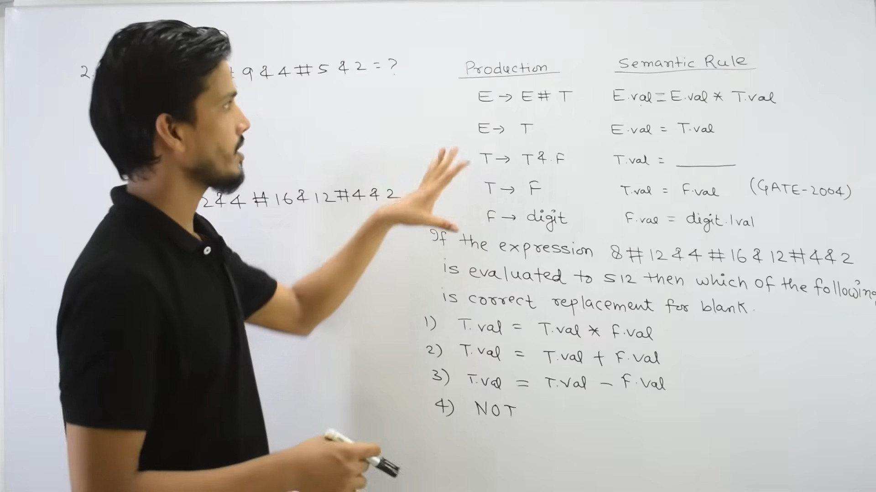

Slide 40
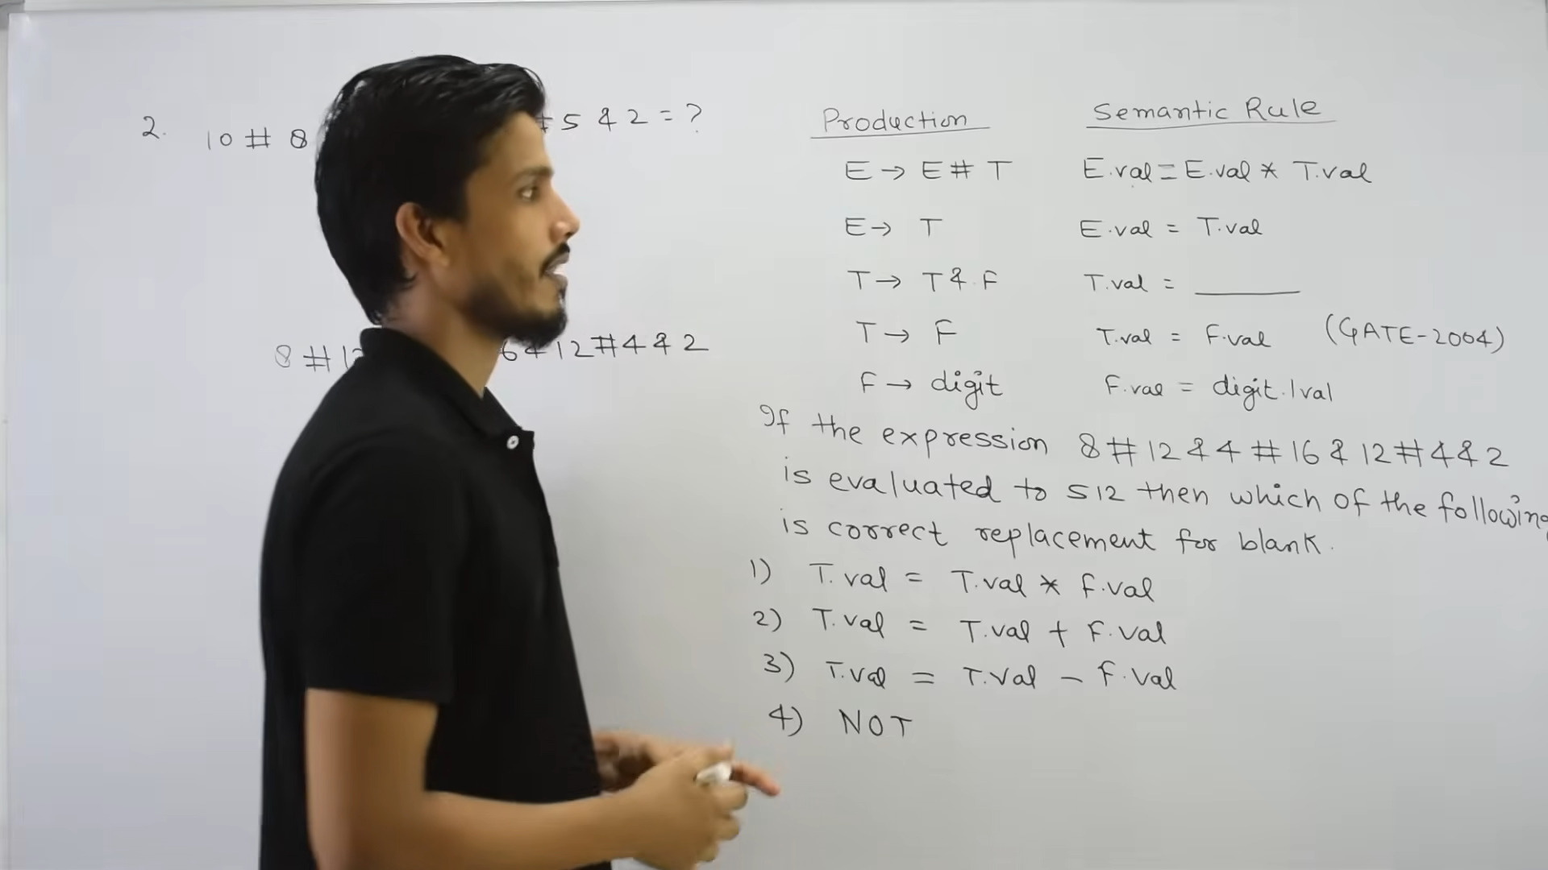

Slide 41
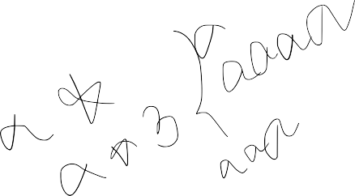
Syntax-Directed Definitions
Syntax-Directed Definitions
A way to systematically associate annotations, e.g. types, to nodes in the grammar/parse tree, calculated by a semantic specification.
Syntax Directed Translation

Slide 42
Syntax-Directed Definitions
Syntax-Directed Definitions
Definition
A syntax-directed definition (SDD) is a context-free grammar with attributes added to the grammar symbols.
attributes are stored in the nodes of the syntax tree.
each production has a set of semantic rules associated for computing the attributes.
If X is a grammar symbol, a is an attribute, then X.a denotes the value of a at node X
Syntax Directed Translation

Slide 43
Example
Syntax-Directed Definitions
Example (Syntax-Directed Definitions) Let the grammar be
E → E + E | num
Then E derives its value from the num tokens in the expression. This is expressed formally by the rules
E.val = E₁.val + E₂.val
E.val = num.lexval
Syntax Directed Translation

Slide 44
Syntax-Directed Definitions
Syntax-Directed Definitions
In a syntax-directed definition, each node has
A set of synthesized attributes, and
A set of inherited attributes.
Syntax Directed Translation

Slide 45

Outline
Synthesized Attributes
1 Abstract Syntax Trees
2 Syntax-Directed Definitions
Synthesized Attributes
3
4 Inherited Attributes
5 Examples
Assignment
6
Syntax Directed Translation

Slide 46
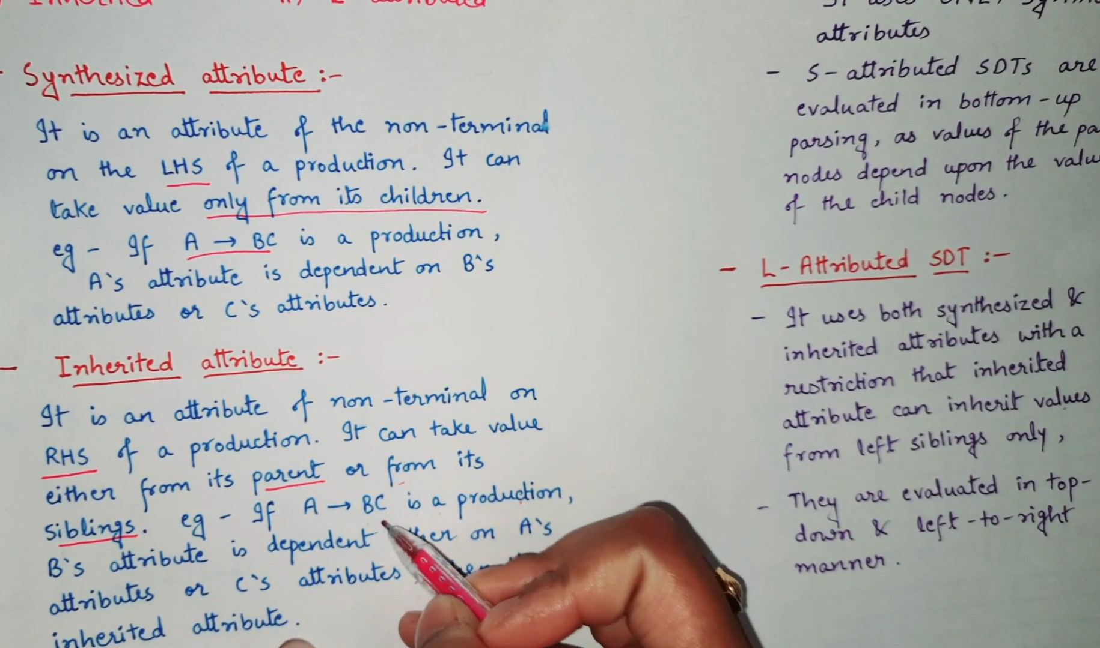

Slide 47
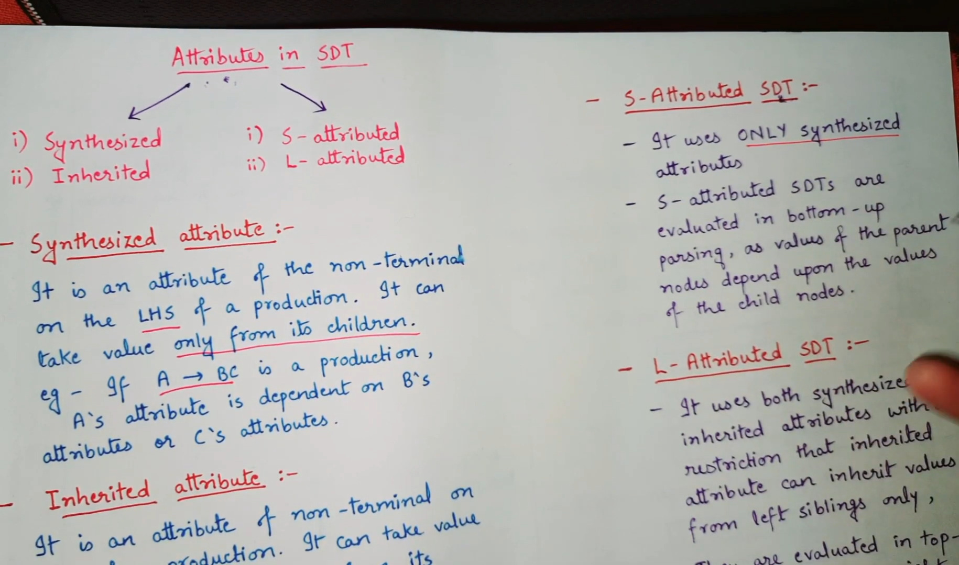

Slide 48
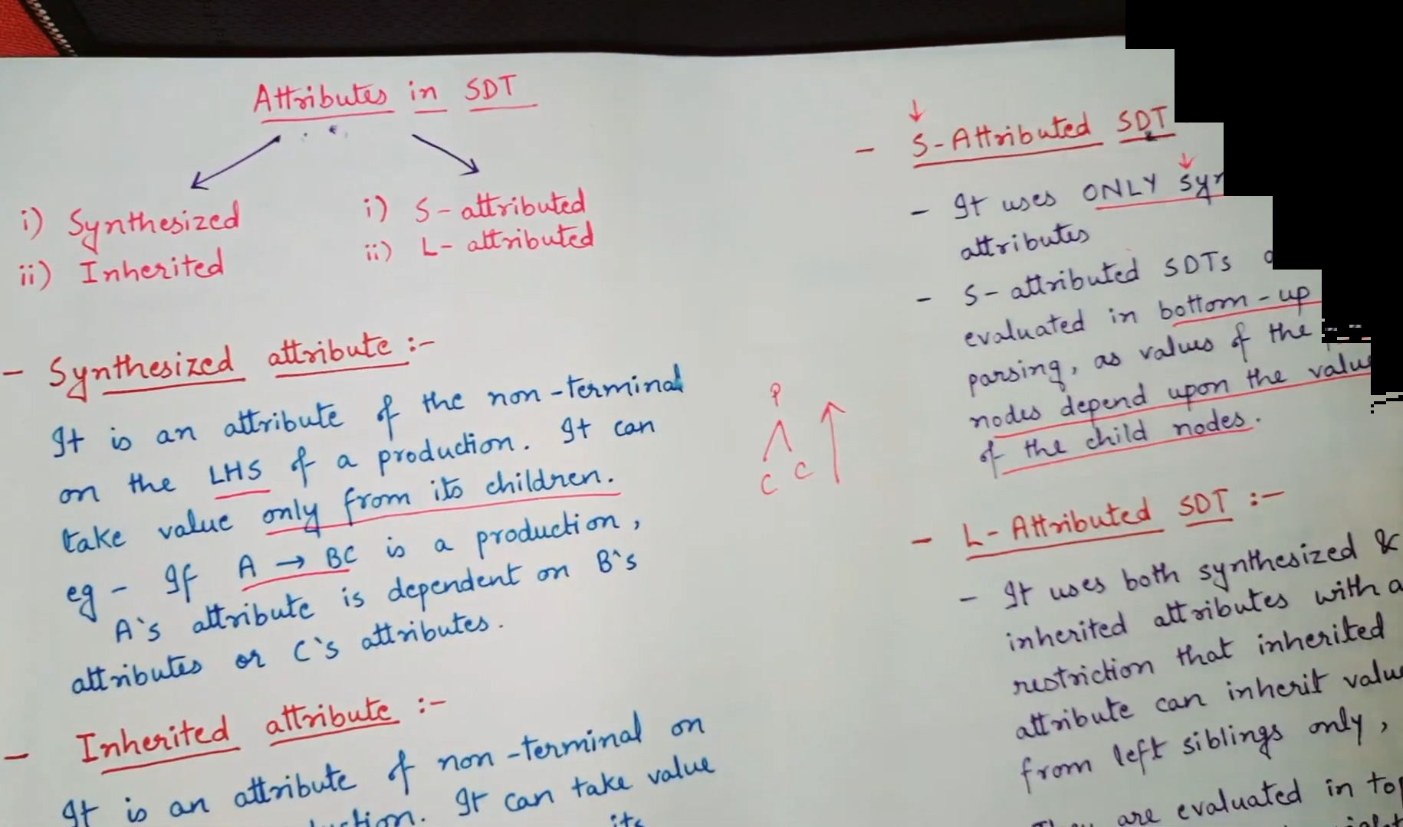

Slide 49
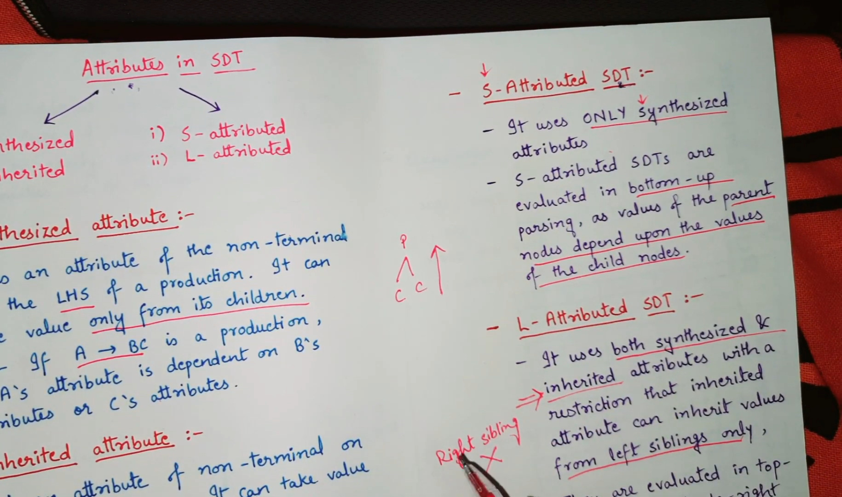

Slide 50
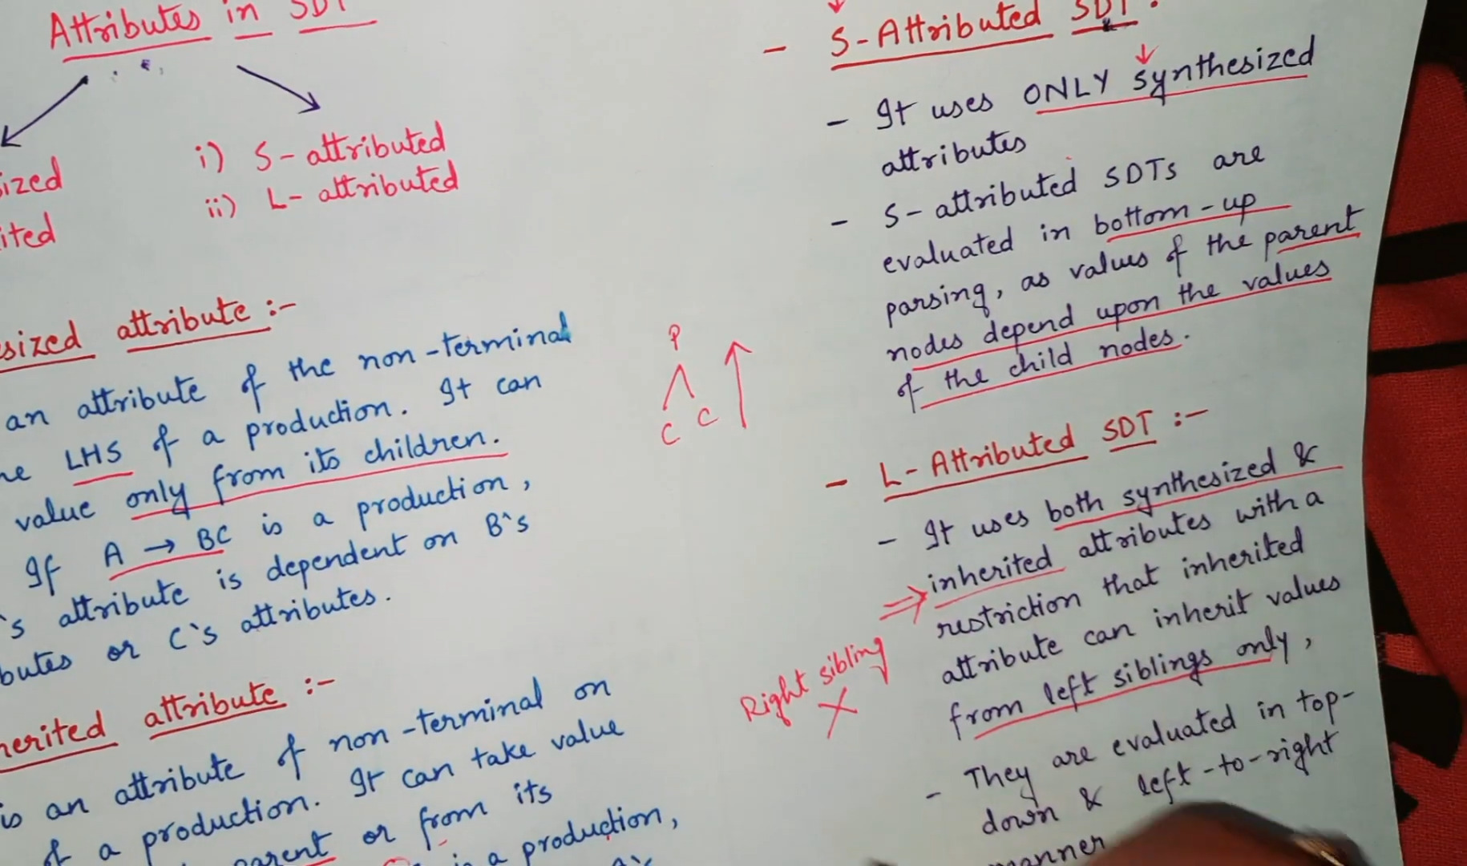

Slide 51
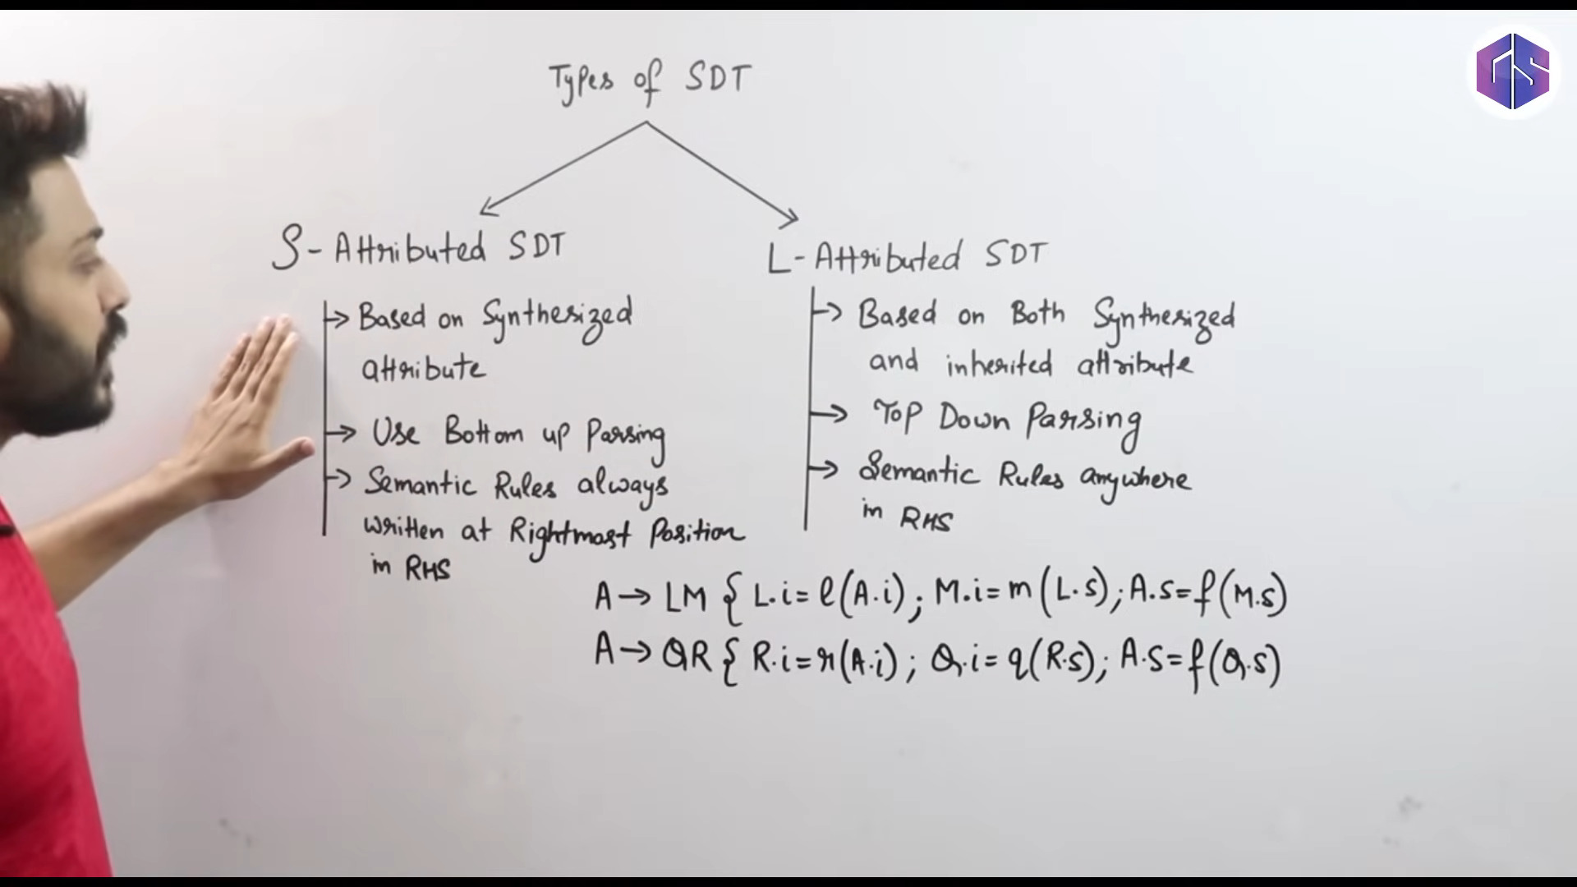

Slide 52
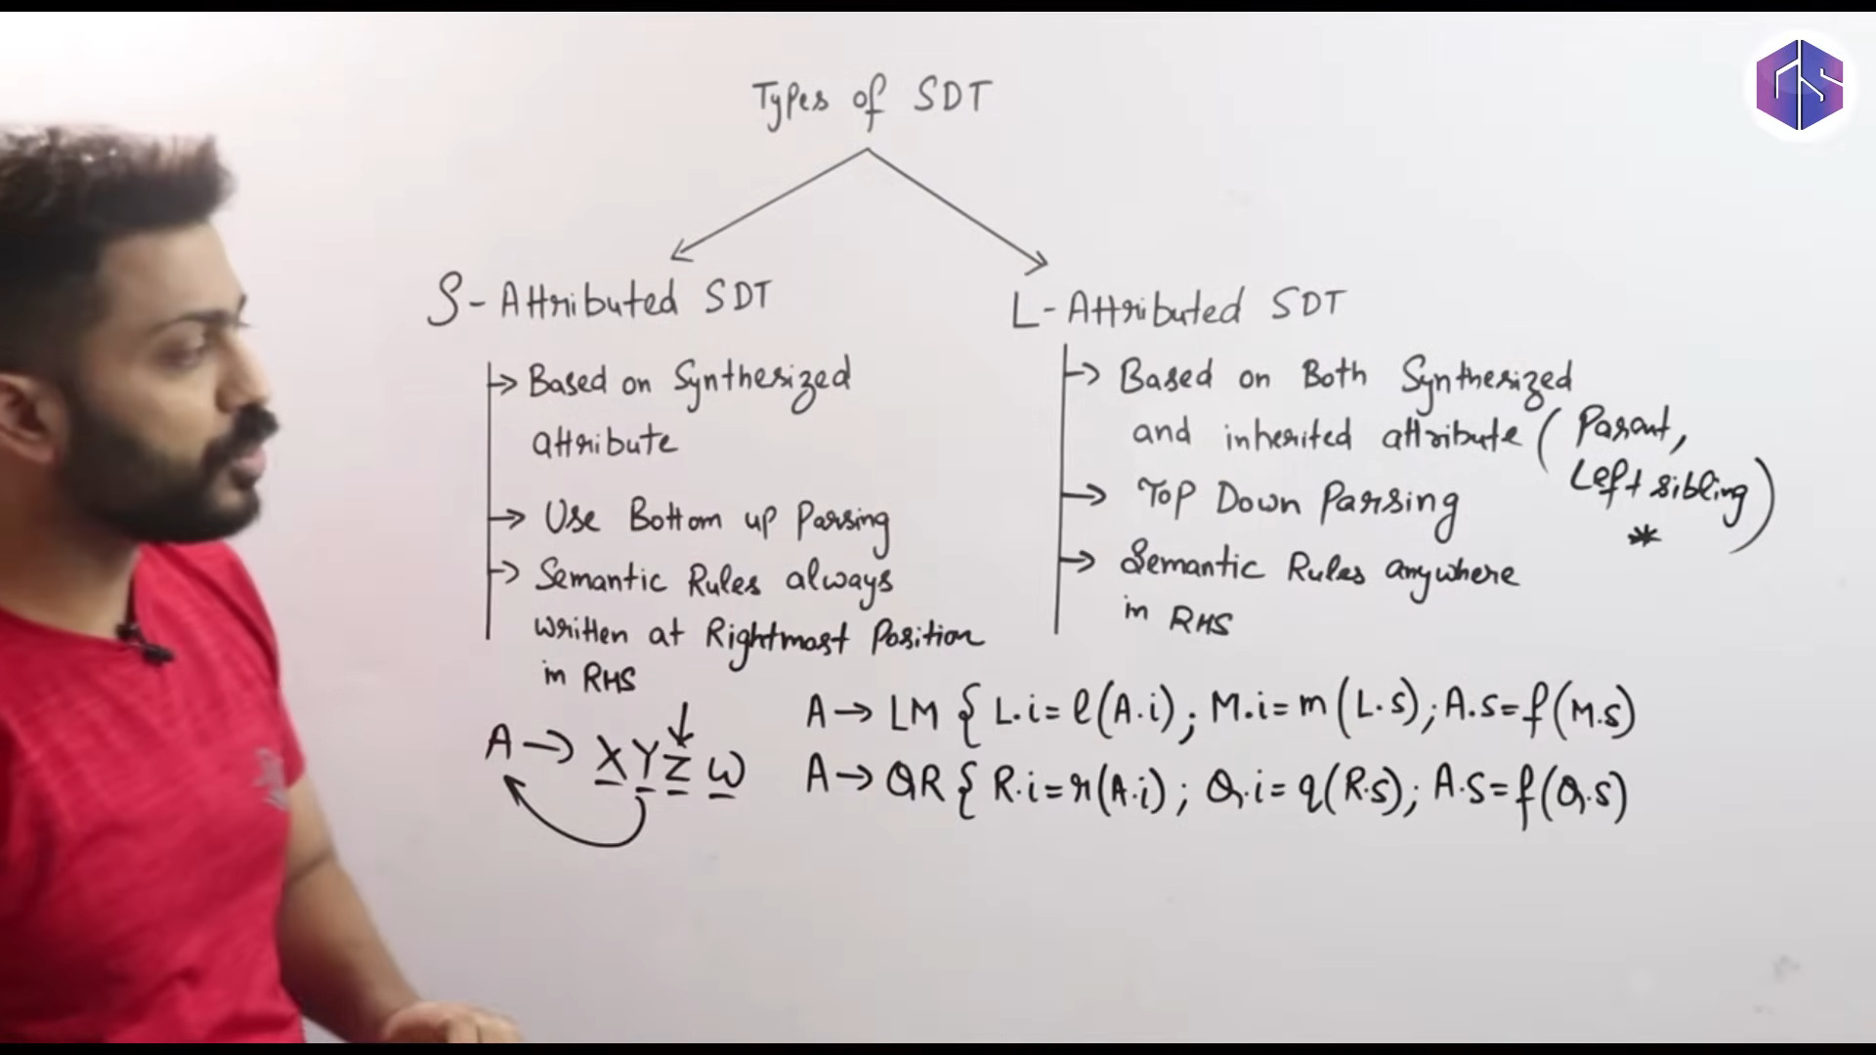

Slide 53
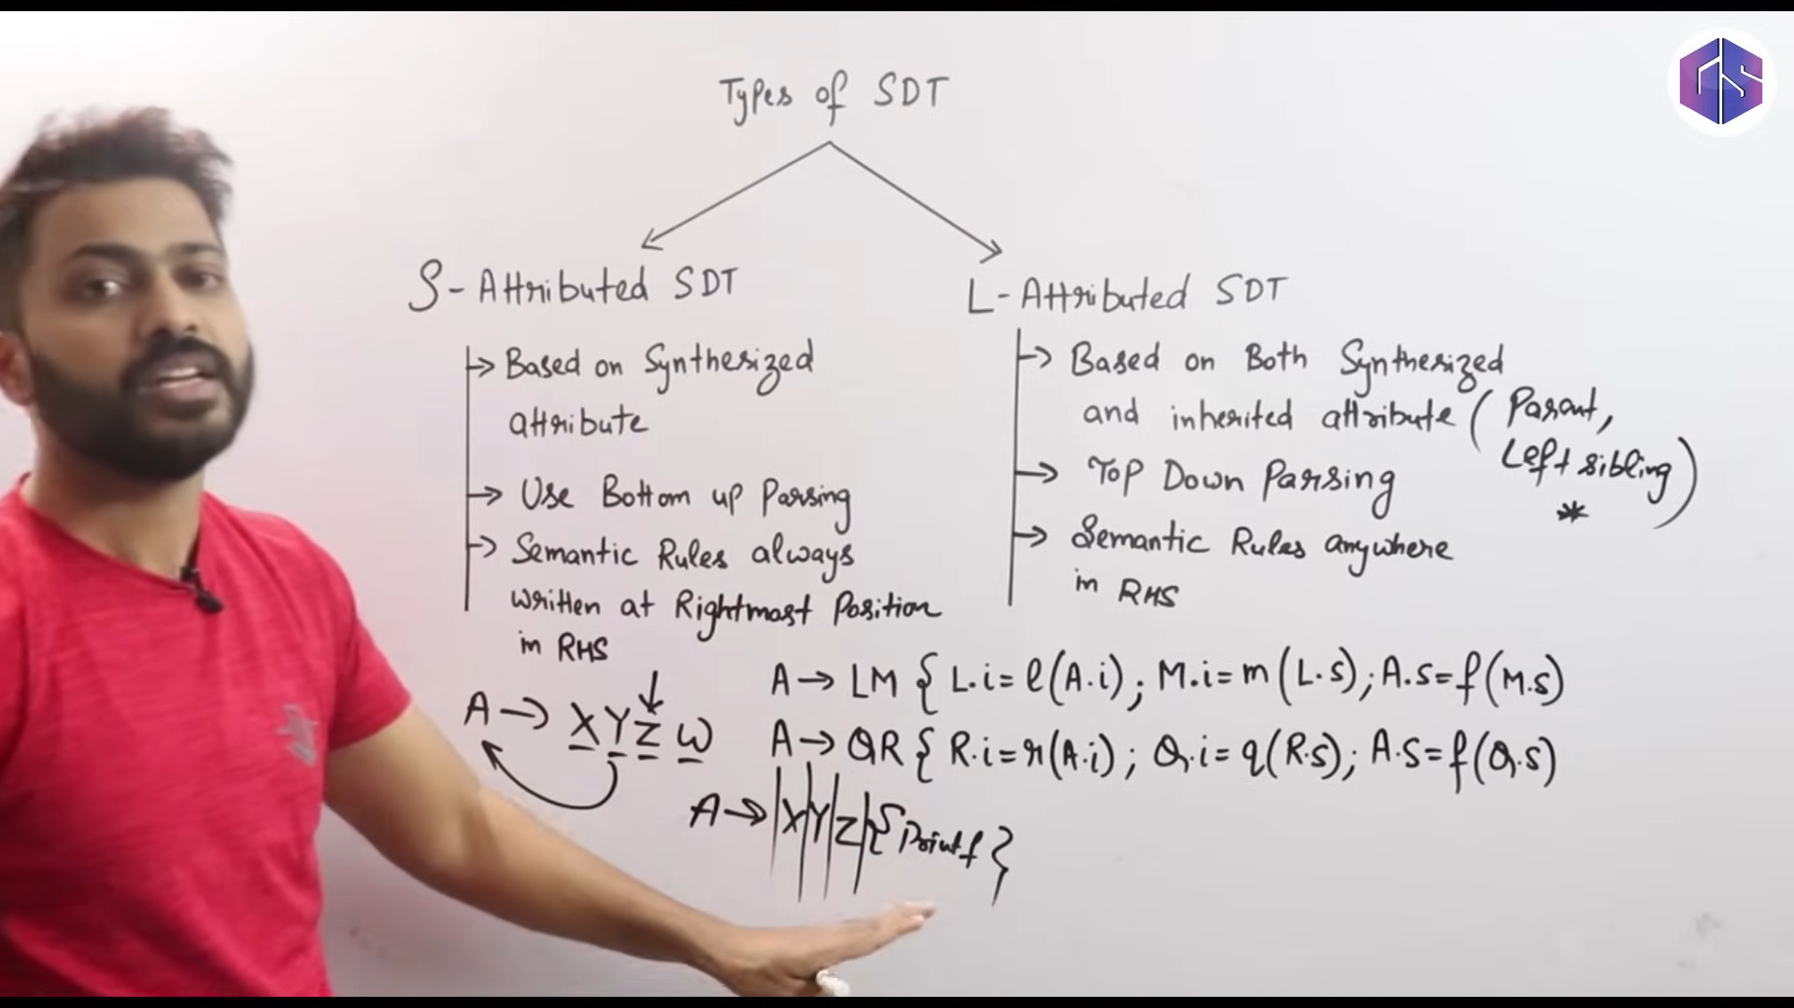

Slide 54
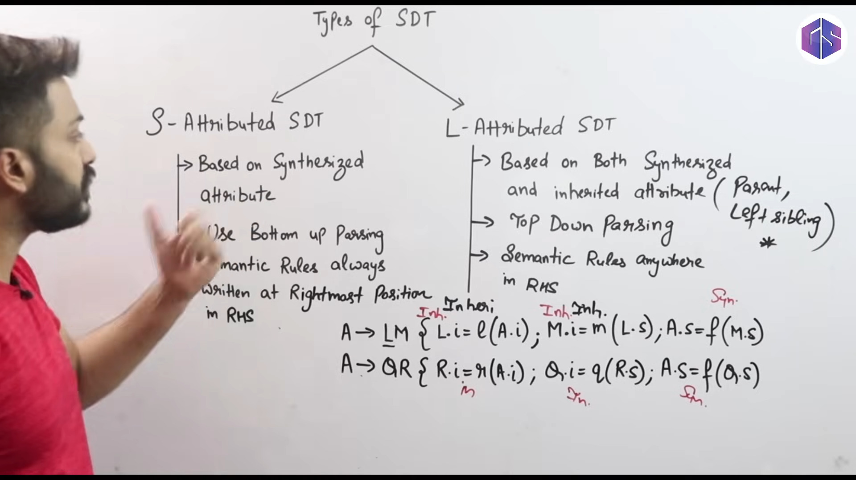

Slide 55
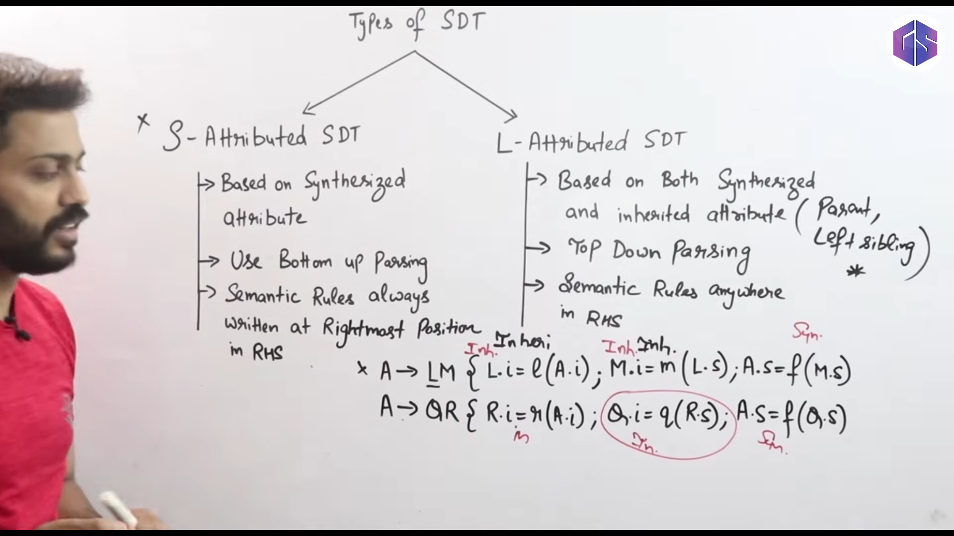

Slide 56
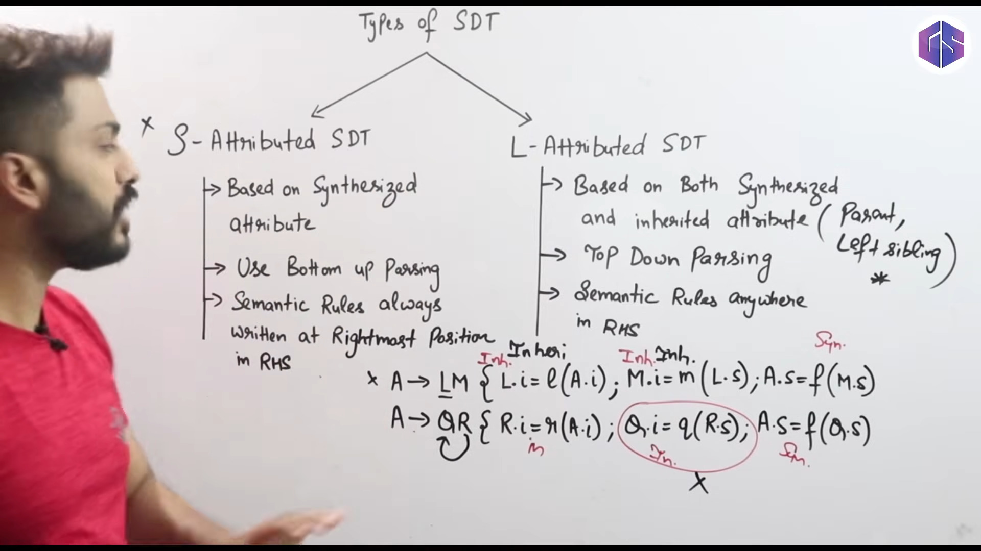

Slide 57
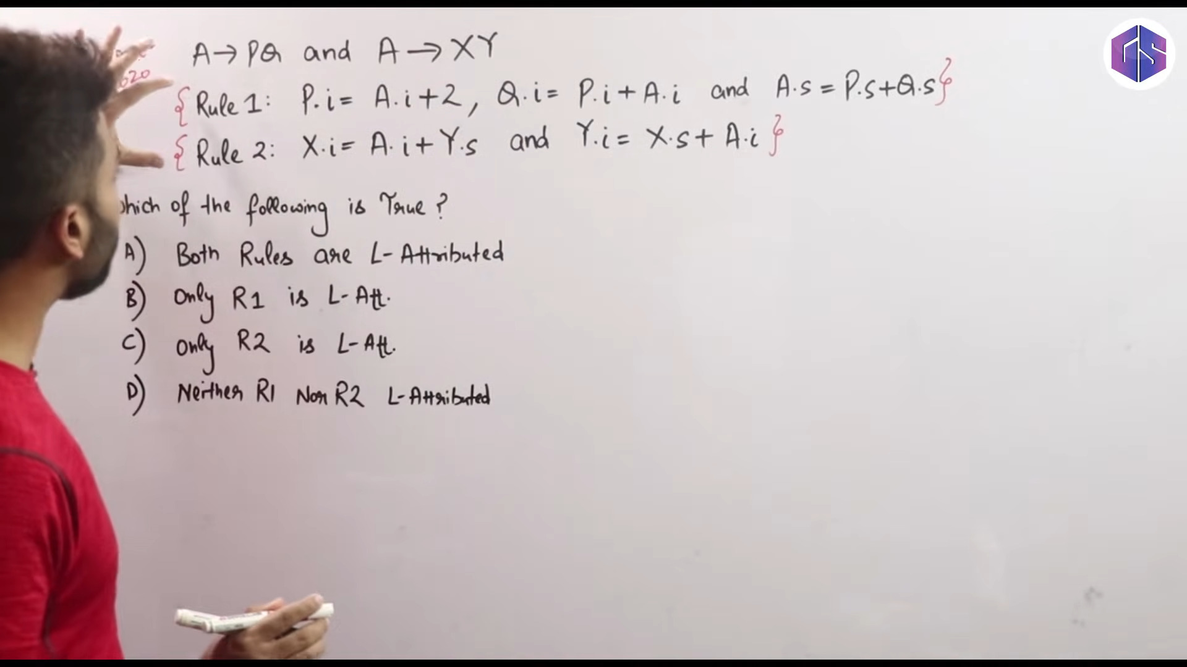

Slide 58
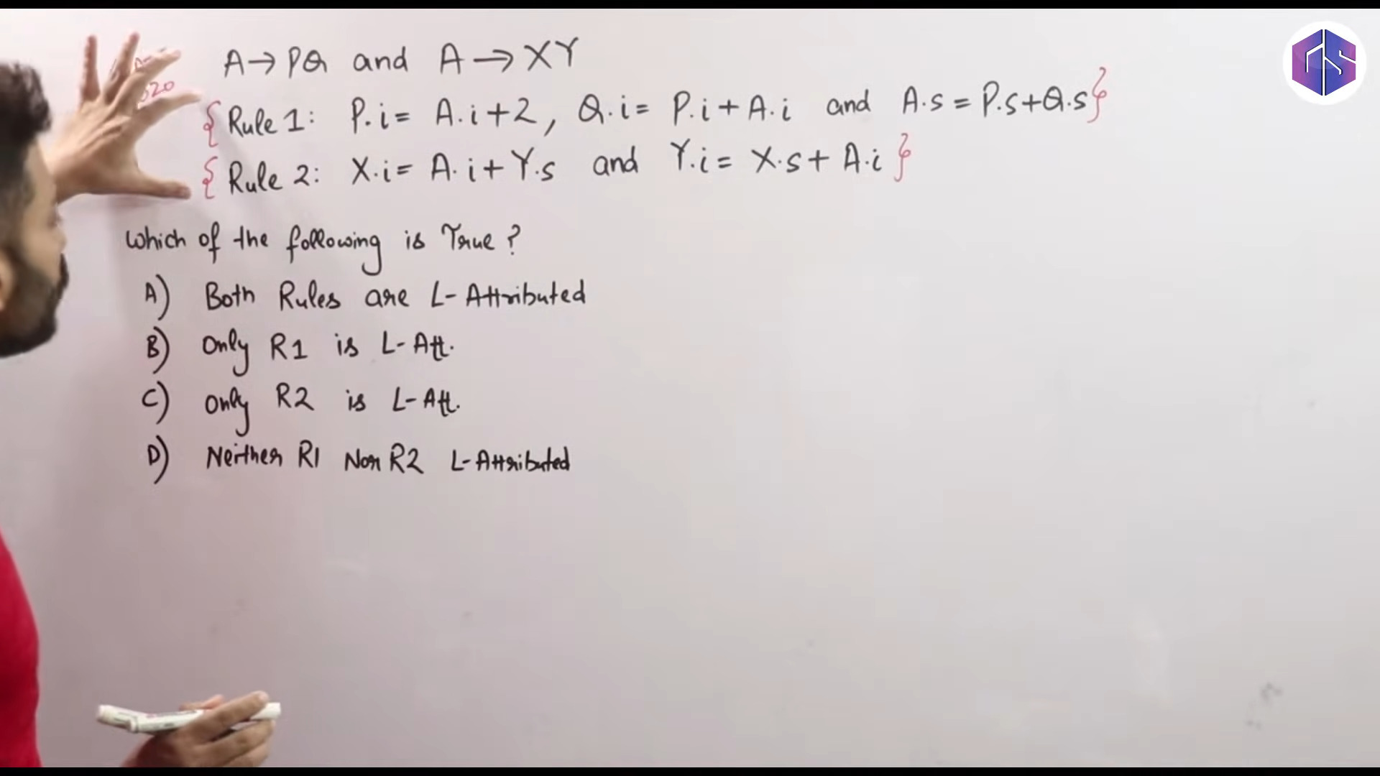

Slide 59
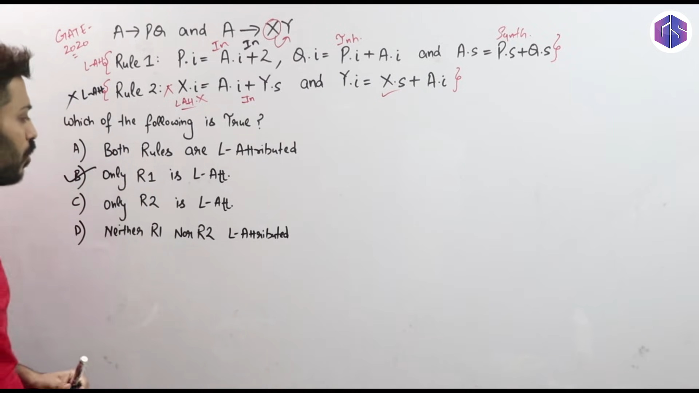

Slide 60
Synthesized Attributes
Synthesized Attributes
Definition
A synthesized attribute of a grammar symbol is a property that is determined by the attributes of the symbols below it in the parse tree.
In other words, if A → α is a production, then A’s synthesized attributes are determined by the attributes of the symbols in α.
Syntax Directed Translation

Slide 61
Synthesized Attributes
Synthesized Attributes
If the AST represents a numerical expression, then the value of the root node is determined by the values of the nodes below it in the tree.
Thus, the value of the root node is a synthesized attribute.
Syntax Directed Translation

Slide 62
Example
Synthesized Attributes
Example (Synthesized Attributes)
The terminals get their values directly from the lexical analyzer.
For example, a num token’s value attribute would be the numerical value of the string of digits in the token.
Syntax Directed Translation

Slide 63
Example
Synthesized Attributes
Example (Synthesized Attributes)
expr.val
expr₁.val
+
expr₂.val
num.lexval
num.lexval
100
250
Syntax Directed Translation

Slide 64
Example
Synthesized Attributes
Example (Synthesized Attributes)
expr.val
expr₁.val
+
expr₂.val
num.lexval
num.lexval
from lexer
from lexer
100
250
Syntax Directed Translation

Slide 65
Example
Synthesized Attributes
Example (Synthesized Attributes)
expr.val
E.val = num.lexval
expr₁.val
+
expr₂.val
synthesized
synthesized
num.lexval
num.lexval
from lexer
from lexer
100
250
Syntax Directed Translation

Slide 66
Example
Synthesized Attributes
Example (Synthesized Attributes)
expr.val
synthesized
synthesized
expr₁.val
+
expr₂.val
synthesized
synthesized
num.lexval
num.lexval
from lexer
from lexer
100
250
Syntax Directed Translation

Slide 67

Outline
Inherited Attributes
1 Abstract Syntax Trees
2 Syntax-Directed Definitions
Synthesized Attributes
3
4 Inherited Attributes
5 Examples
Assignment
6
Syntax Directed Translation

Slide 70
Inherited Attributes
Inherited Attributes
Definition
An inherited attribute is a property of a symbol (node) that is determined by its parent node and its siblings in the parse tree.
In other words, if β is symbol on the right side of the production A → αβγ, then β’s inherited attributes are determined by the attributes of A and the other symbols in α and γ.
Syntax Directed Translation

Slide 71
Example
Inherited Attributes
int a, b, c;
dcl => type list => int list => int list, id => int list, id, id => int id, id, id
Example (Inherited Attributes)
Consider the grammar for a declaration containing one or more identifiers.
dcl → type list
list → list , id | id
type → int | float
int a, b, c;
Syntax Directed Translation

Slide 72
Example
Inherited Attributes
Example (Inherited Attributes)
For example, the declaration might be
float a, b, c;
The attribute “float” first appears as the type of the float token. From there it is passed to the identifiers a, then b, then c.
Syntax Directed Translation

Slide 73

Example
Inherited Attributes
float a, b
Example (Inherited Attributes)
dcl
type.type
FLOAT
float
list.type
list.type
id₁.type
,
id₂.type
Syntax Directed Translation

Slide 74
Example
Inherited Attributes
Example (Inherited Attributes)
dcl
type.type
FLOAT
float
list.type
list.type
id₁.type
,
id₂.type
from lexer
Syntax Directed Translation

Slide 75
Example
Inherited Attributes
Example (Inherited Attributes)
dcl
type.type
list.type
synthesized
FLOAT
list.type
id₁.type
,
id₂.type
from lexer
float
Syntax Directed Translation

Slide 76
Example
Inherited Attributes
Example (Inherited Attributes)
dcl
inherited
list.type
type.type
synthesized
FLOAT
list.type
id₁.type
,
id₂.type
from lexer
float
Syntax Directed Translation

Slide 77
Example
Inherited Attributes
Example (Inherited Attributes)
dcl
type.type
inherited
list.type
inherited
inherited
synthesized
FLOAT
list.type
id₁.type
,
id₂.type
from lexer
float
Syntax Directed Translation

Slide 78
Example
Inherited Attributes
Example (Inherited Attributes)
dcl
type.type
inherited
list.type
inherited
inherited
synthesized
FLOAT
list.type
,
id₂.type
from lexer
inherited
float
id₁.type
Syntax Directed Translation

Slide 79
Some Questions
Inherited Attributes
Questions
In an expression tree, is the type of the expression at the root
inherited or is it synthesized?
Is the type used in an arithmetic operation an inherited attribute or an synthesized attribute of the operator?
In an assignment statement, is the type assigned by the operator an inherited attribute or a synthesized attribute of the operator?
Syntax Directed Translation

Slide 80

Outline
Examples
1 Abstract Syntax Trees
2 Syntax-Directed Definitions
Synthesized Attributes
3
4 Inherited Attributes
5 Examples
Assignment
6
Syntax Directed Translation

Slide 81
Synthesized Attributes
Examples
Example (Synthesized Attributes) Let the grammar be
E → E + T
E → T
T → T * F T → F
F → ( E )
F → num
Syntax Directed Translation

Slide 82
Synthesized Attributes
Examples
Example (Synthesized Attributes)
The attribute at every node is the value of the nonterminal.
In every case, it is synthesized.
E.val = E.val + T.val E.val = T.val
T.val = T.val × F.val T.val = F.val
F.val = E.val
F.val = num.lexval
Syntax Directed Translation

Slide 83
Inherited Attributes
Examples
Example (Inherited Attributes) Let the grammar be
E → T E′ E′ → + T E′ E′ → ε
T → F T ′
T ′ → * F T ′ T ′ → ε
F → ( E )
F → num
Syntax Directed Translation

Slide 84
Inherited Attributes
Examples
Example (Inherited Attributes)
The attribute at the nodes E, T , and F is the value of the nonterminal.
In some cases, it is synthesized. In other cases, it is inherited.
Syntax Directed Translation

Slide 85
Inherited Attributes
Examples
Example (Inherited Attributes) For the production
F → num
we have the rule
F.val = num.lexval
For the production
F → ( E )
we have the rule
F.val = E.val
Syntax Directed Translation

Slide 86
Inherited Attributes
Examples
Example (Inherited Attributes)
Consider the parse tree for the expression
3 ∗ 4 + 5.
Syntax Directed Translation

Slide 87
Examples
Inherited Attributes
Example (Inherited Attributes)
E
T
E'
F
num
T'
+
T
E'
ε
*
F
T'
ε
F
num
T'
ε
num
The parse tree
Syntax Directed Translation

Slide 88
Examples
Inherited Attributes
Example (Inherited Attributes)
E
T
E'
F
num
T'
+
T
E'
ε
3
*
F
T'
ε
F
num
T'
ε
num 4
5
num gets its values from the lexer
Syntax Directed Translation

Slide 89
Inherited Attributes
Examples
Example (Inherited Attributes)
E
T
E'
F
num
+
T
E'
ε
3
T'
3
*
F
4
T'
ε
F
num
T'
ε
5
num
4
5
F.val = num.lexval
Syntax Directed Translation
45

Slide 90
Examples
Inherited Attributes
Example (Inherited Attributes)
T ′.inh = F.val
Syntax Directed Translation

Slide 91
Inherited Attributes
Examples
Example (Inherited Attributes)
How does T (in the production T → F T ′) get its value? It must multiply 3 and 4 to get 12.
So, first T ′ inherits 3 from F .
Then, in the production T ′ → * F T ′ , T ′ inherits 12 from T ′ and
1 1
F .
Then, T ′ turns around and synthesizes 12 from T ′ .
1
Then, back in the production T → F T ′, T synthesizes 12 from T ′.
Syntax Directed Translation

Slide 92
Inherited Attributes
Examples
Example (Inherited Attributes)
E
T
E'
inh 3
F
num
+
T
E'
ε
3
T' 12
*
4
3
*
F
4
T'
ε
F
num
T'
ε
5
num
4
5
T ′.inh = F.val
Syntax Directed Translation

Slide 93
Inherited Attributes
Examples
Example (Inherited Attributes)
E
T
E'
inh 3
F
num
+
T
E'
ε
3
T'
inh 12
3
*
F
4
T'
ε
12
F
num
T'
ε
5
num
4
5
T ′.inh = T ′.inh × F.val
1
Syntax Directed Translation

Slide 94
Inherited Attributes
Examples
Example (Inherited Attributes)
E
T
E'
inh 3
F
num
+
T
E'
ε
3
T'
inh 12
3
*
F
4
T'
ε
12
F
num
T'
ε
5
num
4
5
T ′.syn = T ′.inh
Syntax Directed Translation

Slide 95
Inherited Attributes
Examples
Example (Inherited Attributes)
E
T
E'
inh 3
F
num
+
T
E'
ε
3
T'
syn 12
3
*
F
4
T'
ε
12
F
num
T'
ε
5
num
4
5
T ′.syn = T ′.syn
1
Syntax Directed Translation

Slide 96
Inherited Attributes
Examples
Example (Inherited Attributes)
E
T
syn 12
E'
inh 3
F
num
+
T
E'
ε
3
T'
syn 12
3
*
F
4
T'
ε
12
F
num
T'
ε
5
num
4
5
T.val = T ′.syn
Syntax Directed Translation
52

Slide 97
Inherited Attributes
Examples
Example (Inherited Attributes)
E
inh 12
T
syn 12
E'
inh 3
F
num
+
T
E'
ε
3
T'
syn 12
3
*
F
4
T'
ε
12
F
num
T'
ε
5
num
4
5
E′.inh = T.val
Syntax Directed Translation

Slide 98
Examples
Inherited Attributes
Example (Inherited Attributes) We now have the rules
Production | Semantic Rules
T → F T ′ | T ′.inh = F.val T.val = T ′.syn
T ′ → * F T ′ 1 | T ′.inh = T ′.inh × F.val 1 T ′.syn = T ′.syn 1
T ′ → ε | T ′.syn = T ′.inh
F → num | F.val = num.lexval
Syntax Directed Translation

Slide 99
Examples
Inherited Attributes
Example (Inherited Attributes) As well as the rules
Production | Semantic Rules
E → T E′ | E′.inh = T.val E.val = E′.syn
E′ → + T E′ 1 | E′ .inh = E′.inh + T.val 1 E′.syn = E′ .syn 1
E′ → ε | E′.syn = E′.inh
Syntax Directed Translation

Slide 100

Outline
Assignment
1 Abstract Syntax Trees
2 Syntax-Directed Definitions
Synthesized Attributes
3
4 Inherited Attributes
5 Examples
Assignment
6
Syntax Directed Translation

Slide 101
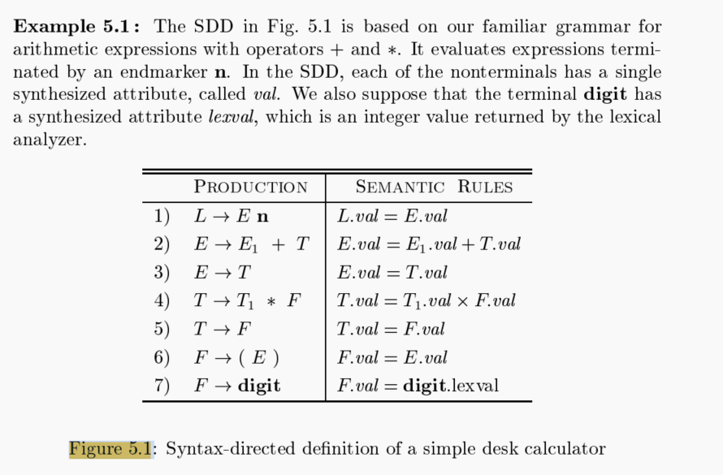

Slide 102
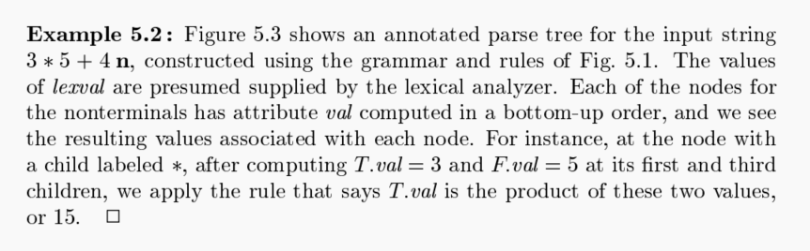

Slide 103
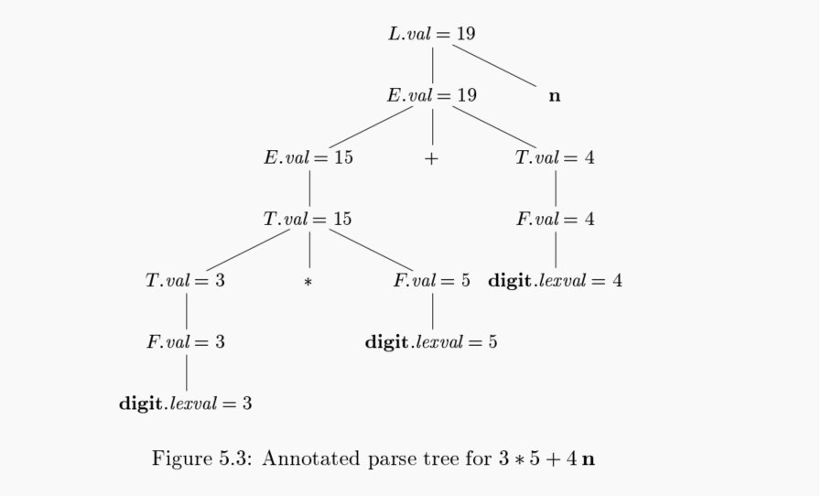

Slide 104
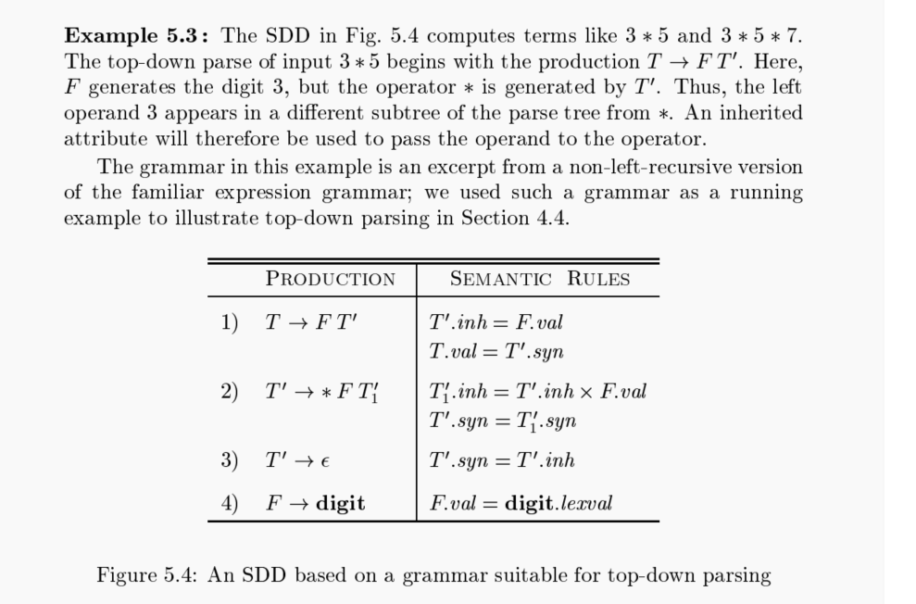

Slide 105
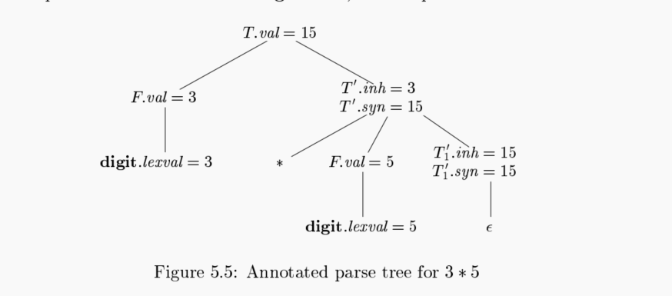

Slide 107
Assignment
Assignment
Homework
p. 309: 1, 2, 3
Syntax Directed Translation

Slide 108
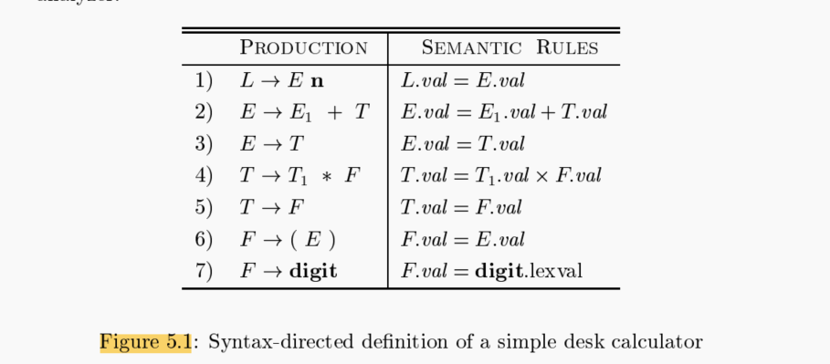
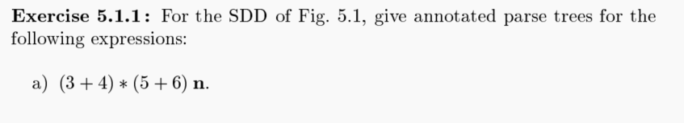
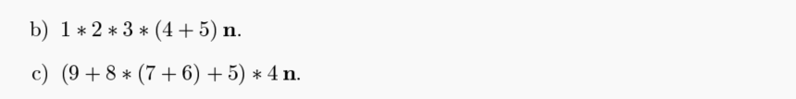

Slide 109


Slide 110


Slide 111


Slide 112


Slide 113


Slide 114


Slide 115


